Slide 1
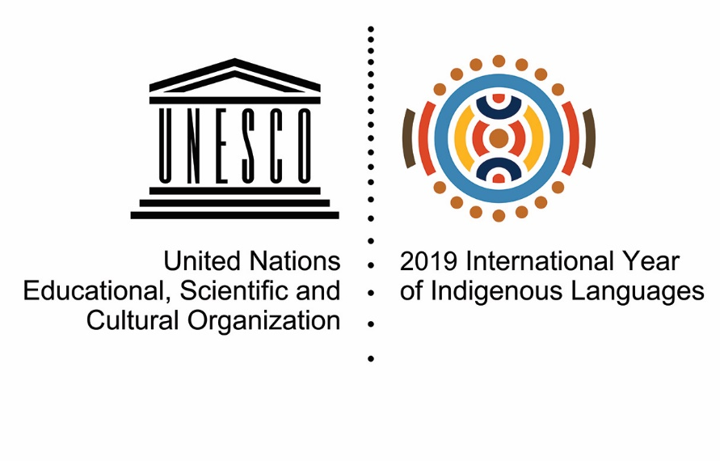
Linguistic diversity: global and local challenges Diversidad lingüística: desafíos globales y locales
International Congress on Languages at Risk, 24 February 2020 in Mexico City, Mexico Congreso internacional sobre lenguas en riesgo 24 de febrero de 2020 en la Ciudad de México, México
Dr Irmgarda Kasinskaite-Buddeberg Programme specialist Communication and Information Sector UNESCO

Slide 2
The Universal Declaration of Human Rights (1948)
"Everyone is entitled to all the rights and freedoms set forth in this declaration, without distinction of any kind, such as race, color, sex, language, religion...".
La Declaración Universal de Derechos Humanos (1948)
"Toda persona tiene todos los derechos y libertades proclamados en esta declaración, sin distinción alguna de raza, color, sexo, idioma, religión...".
Notes:
The Universal Declaration of Human Rights (UDHR) is a milestone document in the history of human rights. Drafted by representatives with different legal and cultural backgrounds from all regions of the world, the Declaration was proclaimed by the United Nations General Assembly in Paris on 10 December 1948 (General Assembly resolution 217 A) as a common standard of achievements for all peoples and all nations.
It sets out, for the first time, fundamental human rights to be universally protected, INCLUDING reference to language, and it has been translated into over 500 languages.

Slide 3
UNESCO Constitution
Universal Declaration of Human Rights
Convention 169 Concerning Indigenous and Tribal Peoples in Independent Countries
Recommendation concerning the Promotion and Use of Multilingualism and Universal Access to Cyberspace
Convention for the Safeguarding of the Intangible Cultural Heritage
United Nations Declaration of Indigenous Peoples
Transforming our world: the 2030 Agenda for Sustainable Development
International Year of Indigenous Languages
International Decade of Indigenous Languages
1945 1948 1989 2003 2007 2015 2019 2022-2032
Constitución de la UNESCO
La Declaración Universal de los Derechos Humanos
Convenio 169 sobre pueblos indígenas y tribales en países independientes
Recomendación sobre la promoción y el uso del plurilingüismo y el acceso universal al ciberespacio
Convención para la Salvaguardia del Patrimonio Cultural Inmaterial
Declaración de las Naciones Unidas sobre los pueblos indígenas
Transformando nuestro mundo: la Agenda 2030 para el Desarrollo Sostenible
Año Internacional de las Lenguas Indígenas
Decenio Internacional de las Lenguas Indígenas
Notes:
UNESCO Constitution 1945 Core principle: "Since wars begin in the minds of men, it is in the minds of men that the defences of peace must be constructed...”
UNESCO is also a special UN agency with a mandate to promote “the free flow of ideas by word and image”.
The Universal Declaration of Human Rights (1948) Article 2 states that “Everyone is entitled to all the rights and freedoms set forth in this Declaration, without distinction of any kind, such as race, colour, sex, language, religion, political or other opinion, national or social origin, property, birth or other status”.
No distinction shall be made on the basis of the political, jurisdictional or international status of the country or territory to which a person belongs, whether it be independent, trust, non-self-governing or under any other limitation of sovereignty.
___________________________________________________________________________
United Nations Declaration of Indigenous Peoples (2007)
Article 13 states that “Indigenous peoples have the right to revitalize, use, develop and transmit to future generations their histories, languages, oral traditions, philosophies, writing systems and literatures, and to designate and retain their own names for communities, places and persons”.
Today the 2007 Declaration is the most comprehensive international instrument on the rights of indigenous peoples.
There is nearly a 60 years gap between the proclamation of the UN Declaration of Human rights in 1948 and the UN Declaration of Indigenous Peoples in 2007.
Further steps have been taken towards the full integration of indigenous issues into normative frameworks and standard-setting instruments:
IYIL2019: In 2016, the United Nations General Assembly adopted a resolution proclaiming 2019 as the International Year of Indigenous Languages, based on a recommendation by the Permanent Forum on Indigenous Issues, and requested UNESCO to act as UN lead agency for its organization.
In view of the stakeholders and resources mobilized throughout this international year, in December 2019 the UNGA proclaimed the International Decade of Indigenous Languages between 2022 – 2032. There support for the required follow up to the IYIL2019 through the establishment of a global action plan over the decade, on the basis of the recommendations identified in the Outcome Document.
___________________________________________________________________
Transforming our world: the 2030 Agenda for Sustainable Development (2015)
It emphasizes the responsibilities of all States, in conformity with the Charter of the United Nations, to respect, protect and promote human rights and fundamental freedoms for all, without distinction of any kind as to race, colour, sex, language, religion, political or other opinion, national or social origin, property, birth, disability or other status.

Slide 4
Despite the fact that the major international normative instruments acknowledge “language“, until now linguistic rights are not fully acknowledged and integrated into strategic development frameworks and national policies, neither they are supported financially and mainstreamed across different socio-economic, scientific and political domains.
A pesar de que los principales instrumentos normativos internacionales reconocen el "idioma", es obvio que hasta ahora, el papel del lenguaje no se comprende completamente y, por lo tanto, se refleja de manera deficiente en los marcos de desarrollo estratégico, las políticas y estrategias nacionales, y tampoco recinben el apoyo financiero o se integran a través de diferentes dominios socioeconómicos, científicos y políticos.
Notes:
The number of countries implementing comprehensive language policies is not known, as often language is integrated into other policies linked to culture and education.
Some regions/countries have language-related frameworks such as the European Charter for Regional or Minority Languages (1992), which stresses the value of interculturalism and multilingualism, and that protection and encouragement of regional or minority languages should not be at the detriment of the dominant/official languages.
Some countries have adopted national laws such as Canada - The Indigenous Languages Act, intended to support the reclamation, revitalization, maintaining and strengthening of Indigenous languages in Canada and received Royal Assent on June 21, 2019.
The 2030 Sustainable Development Goals Agenda pledges to leave no one behind. However, in general, existing development mechanisms and mainstream policy agendas do not adequately reflect the needs of Indigenous language users, who are at risk of being left behind or even excluded.
In many countries, speakers of non-dominant, minority, lesser-used, or indigenous languages lack access to basic public services, quality education, sustainable employment opportunities, digital technologies and content, and access to scientific information in languages that they can understand.

Slide 5
Exclusion is costly for society
La exclusión es costosa para la sociedad

Slide 6
Poverty and exclusion among indigenous peoples: The global evidence (World Bank, 2016)
Pobreza y exclusión entre los pueblos indígenas: la evidencia global (Banco Mundial, 2016)
Where are these 370 million people, who are they, and why they are so overrepresented among the poor? Only about 8% of the Indigenous Peoples around the world reside in Latin America, a far smaller number than most people surmise. On the other hand, over 75% live in China, South Asia and Southeast Asia, according to World Bank’s first global study of poverty among Indigenous Peoples across the developing world, Indigenous Peoples, Poverty, and Development.
The research found that in every country studied, Indigenous peoples are poorer. The Indigenous poverty headcount is much larger than for the non-indigenous population, and the poverty gap is far larger than the national average. This means that not only are there more Indigenous peoples than non-indigenous classified as poor, but that their poverty is also more severe. This manifests in various ways including insecure land and property rights, discrimination, heightened vulnerability to risk and climate change, and a wide range of health, education and other related socio-economic disparities.
¿Dónde están estos 370 millones de personas, quiénes son y por qué están tan sobrerrepresentados entre los pobres?
Solo alrededor del 8% de los pueblos indígenas de todo el mundo reside en América Latina, un número mucho menor que la mayoría de las personas suponen. Por otro lado, más del 75% vive en China, el sur de Asia y el sudeste asiático, según el primer estudio global de pobreza del Banco Mundial entre los pueblos indígenas de todo el mundo en desarrollo, los Pueblos indígenas, la pobreza y el desarrollo.
La investigación encontró que en todos los países estudiados, los pueblos indígenas son más pobres. El recuento de la pobreza indígena es mucho mayor que el de la población no indígena, y la brecha de pobreza es mucho mayor que el promedio nacional. Esto significa que no solo hay más pueblos indígenas que no indígenas clasificados como pobres, sino que su pobreza también es más severa. Esto se manifiesta de varias maneras, incluyendo la inseguridad de la tenencia de la tierra y los derechos de propiedad, la discriminación, la mayor vulnerabilidad al riesgo y el cambio climático, y una amplia gama de disparidades socioeconómicas relacionadas con la salud, la educación y otras.
http://blogs.worldbank.org/voices/poverty-and-exclusion-among-indigenous-peoples-global-evidence
Notes:
There are about 370 million Indigenous people in the world today, according to estimates. Present in over 90 countries, indigenous communities represent about 5% of the world’s population but make up 15% of the world’s extreme poor , and 1/3 of the rural poor. They live, own and occupy approximately one quarter of the world’s lands and waters which represents 80% of the world’s biodiversity.
Wherever they live, Indigenous Peoples face distinct pressures, including being among the poorest and most marginalized in their societies.
The endangerment of indigenous languages is a trend that concerns both developing and developed countries.
A language is in danger when its speakers and users stop using it, use it less and less, or stop passing it on from one generation to the next. Of the approximately 6,700 languages known in the world, more than 2,680 languages are now endangered
It is estimated that a majority of users of vulnerable languages including indigenous ones are from low- or middle-income economies.
Forced migration due to conflict or lack of opportunity/healthcare/public services/discrimination and other is another important reason for the endangerment of indigenous languages. Once a family decides to leave its home, the family members, in particular children/youth become more vulnerable to external conditions, and their communication with other family members, is limited /interrupted.

Slide 7
Poverty and exclusion among indigenous peoples: The global evidence (World Bank, 2016)
Pobreza y exclusión entre los pueblos indígenas: la evidencia global (Banco Mundial, 2016)
What can be done? Why has poverty been more widespread, more severe, and harder to overcome for Indigenous peoples – and what can be done about it? A myriad of factors likely underpin the ‘stickiness’ of the Indigenous poverty gap – geographical and political exclusion, historical oppression, limited infrastructure and physical capital assets, heightened exposure to risk, etc. – but there is emerging evidence that investing in early childhood development and reducing discrimination are especially critical keys to unlocking the indigenous poverty trap.
¿Qué se puede hacer?
¿Por qué la pobreza ha sido más generalizada, más severa y más difícil de superar para los pueblos indígenas, y qué se puede hacer al respecto? Es probable que haya una miríada de factores que sustentan la "adherencia" de la brecha de pobreza indígena: exclusión geográfica y política, opresión histórica, infraestructura limitada y activos de capital físico, mayor exposición al riesgo, etc., pero hay evidencia emergente de que invertir en el desarrollo de la primera infancia y reducir la discriminación son claves especialmente críticas para desbloquear la trampa de la pobreza indígena.
Gillette Hall and Ariel Gandolfo (2016, World Bank)
http://blogs.worldbank.org/voices/poverty-and-exclusion-among-indigenous-peoples-global-evidence
Notes:
The lack of recognition and social exclusion of indigenous languages users puts them into greater risk of experiencing poverty, hunger, unemployment, pushing them to the margins of societies; . If immediate action is not taken, there will be a gradual loss of indigenous languages and the rich knowledge systems associated to them.
Therefore, public recognition accorded to a certain language contributes to the recognition and social inclusion of the entire community of its users;
It is in this context that the proclamation of a DECADE OF INDIGENOUS LANGUAGES, strongly supported by many stakeholders, becomes a global priority, as there are nearly 10 years to go to achieve the set targets of the 2030 Agenda. One of the objectives is mainstreaming a view of Linguistic diversity is an increadibly valuable resource that contributes to global human development and that promoting linguistic diversity involved protecting the human rights and fundamental freedoms of language users.
Therefore, policy collaboration and continuity of action are essential for promoting, protecting and strengthening Indigenous languages as well as empowering their users around the world. This approach implies capitalizing on the full range of international, regional and national normative instruments and existing tools from previous years, and develop a global action plan that includes concrete recommendations for strategic and joint actions.

Slide 8
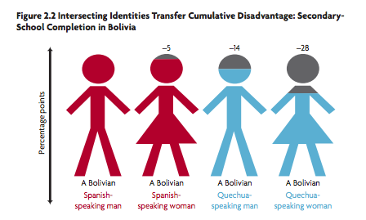
The double-disadvantage / La doble desventaja
las identidades que se cruzan transfieren la desventaja acumulativa: finalización de la escuela secundaria en Bolivia
World Bank. 2013. Inclusion Matters, the Foundation for Shared Prosperity. p. 75.
Figure shows the probability of completing secondary school relative to a Spanish speaking man, for those age 25 years or older.
Banco Mundial. 2013. Inclusion Matters, la Fundación para la Prosperidad Compartida. pag. 75)
La figura muestra la probabilidad de completar la escuela secundaria en relación con un hombre de habla hispana, para aquellos de 25 años o más.
Notes:
Indigenous women face significant challenges to the full enjoyment of their human rights. Indigenous women experience multiple forms of discrimination, often lack access to education, health care and ancestral lands, face disproportionately high rates of poverty and are subjected to violence, such as domestic violence and sexual abuse, including in the contexts of trafficking and armed conflict.
Women are traditionally “the keepers” of indigenous languages, ensuring the transmission to younger generations. However, in view of the growing rates of poverty in rural areas – where most indigenous communities are based – there has been an increase in migration of indigenous women, in search of employment, to cities, where they face the danger of exploitation and inhumane treatment. This has often forced indigenous women to leave their children behind and being unable to exercise their role as educators at home.
Additionally, indigenous women and men are deprived of educational opportunities because of lack of mother tongue education, geographical barriers to accessing schools as well as economic obstacles. Such barriers are more stringent for indigenous women, who also face gender-based discrimination (as it can be seen from the graph in the slide).

Slide 9
Is language loss inevitable?
Loss in general is inevitable, while some forms of loss affect just one person, one family, other can affect an entire community or nation.
When a language is lost, the result will impact the health and vitality of an entire community for generations to come.
¿La pérdida de idiomas es inevitable?
La pérdida en general es inevitable, mientras que algunas formas de pérdida afectan solo a una persona, una familia, y otras pueden afectar a toda una comunidad o nación.
¿La pérdida del lenguaje es una pérdida para la humanidad? Cuando una lengua se pierde, esta pérdida tendra un impacto en la salud y la vitalidad de la comunidad entera durante las generaciones por venir
Notes:
Loss in general is inevitable, while some forms of loss affect just one person, one family, other can affect an entire community or nation.
When a language is lost, the result can be a loss of identity, one that may impact the health and vitality of a community for generations to come.
Languages usually reach the point of crisis after being displaced by a socially, politically and economically dominant one. Sometimes, especially in immigrant communities, parents will decide not to teach their children their heritage language, perceiving it as a potential hindrance to their success in life, by proving a language of prestige.
Additionally, the decline of linguistic diversity is linked to the loss of biodiversity. 70% of the world's languages were found within the planet's biodiversity hotspots. Data showed that as these important environmental areas were degraded over time, cultures and languages in the area were also being lost. Indeed, the sharp decline in biodiversity that can be observed is affecting every region of the world, threathening the ability of people to find necessary goods for their life such as water, clean air and food.

Slide 10
L
The survival of languages is strictly dependent
on people’s ability to use them in their everyday life
Languages
Idiomas
People/ Language users
Personas/ usuarios de idiomas
La supervivencia de los idiomas depende estrictamente
de la capacidad de las personas para usarlos en la vida diaria
Notes:
Language users ensure the continuity, transmission, revival and vitality of languages. They are therefore the primary actors responsible and accountable for languages’ survival.
Several individuals and communities who’s mother tongue are minority, lesser-used and indigenous languages are keen supporters and promoters of their own languages, as they are aware and confident of their value. However, in many instances they do not have the means or are in the condition to be able to support their own languages.
In a few moments, I will explore the structural factors and others forces preventing users of minority, lesser-used and indigenous languages to exercise the right to use their languages in their everyday life, to participate to society, receive an education, access to the job market, healthcare, and other key services.
For now, I would like to emphasize the strong, intrinsic relation between languages and peoples; the simple yet fundamental fact that languages would be lost and stop existing if they were not used by people. Let’s therefore focus on LANGUAGE USERS.
There must be a radical change in the way in which languages are conceived. Languages are not simply related to linguistic issues, but rather encompass all aspects of human life. A full spectrum of human rights should be applied to language-endangerment issues; this involves positing linguistic rights as a fundamental part of human rights and fundamental freedoms.

Slide 11
Integrating indigenous languages into the global development agenda: Why is it important? What actors should lead the process? and How?
¿ Integración de las lenguas indígenas la agenda mundial de desarrollo:
¿Por qué es importante? ¿Qué actores deberían dirigir el proceso? y ¿Cómo?
Notes:
UNESCO’s objective goes beyond the establishment of an international instrument on language related issues – such a Convention, Treaty or another document. It is rather about engaging in concrete actions, establish national, regional and global action plans, mobilize partners and resources – throughout the decade of indigenous languages to achieve concrete results and impact worldwide.
WHY: The Key message underpinning the Action Plan for the Implementation of the IYIL2019 is that indigenous languages matter for peace-building, sustainable development and reconciliation in our societies. I would like to demonstrate the validity of this message through some CASE STUDIES (next slides).
WHO: Multi-stakeholder partnership that sees the joint efforts, collaboration and involvement of all interested parties in mobilizing necessary support for indigenous languages, includes Member States, members of the Steering Committee, United Nations entities, Indigenous-specific United Nations three-party mechanisms (UNPFII, Special Rapporteur, EMRIP), Academia, Non-governmental organizations (NGOs), Civil society, Public institutions and the private sector, Other organizations.
HOW: A global action plan that includes guidelines and recommendations for policy-making will be prepared through various consultations among different stakeholders during the 2 years preparatory periods towards the decade of indigenous languages 2022 – 2032.

Slide 12
Empowering language-users requires
Empoderar a los usuarios del lenguaje requiere
Addressing the causes affecting people’s capacity to use their languages in their everyday lives by developing appropriate resources, mobilizing partners, and providing new opportunities;
Investing in building human capacities to allow language-users make their own decisions and engage in concrete actions;
Integration of language issues into a broader context, including political, economic, cultural, technological and societal development strategies.
Abordar las causas que inciden en la capacidad de las personas para utilizar sus idiomas en su vida cotidiana mediante el desarrollo de recursos adecuados, la movilización de socios y la creación de nuevas oportunidades;
Invertir en la creación de capacidades humanas para permitir que los usuarios del lenguaje tomen sus propias decisiones y participen en acciones concretas;
Integración de las cuestiones idiomóticas en estrategias de desarrollo políticas, económicas, culturales, tecnológicas y sociales más amplias.
Notes:
Acknowledgment of the these languages’ value involves a view of language users as national assets that can contribute to sustainable development, innovation, creation of more equitable/inclusive societies.
Language cannot be studied, promoted, supported by linguists alone. Documentation is only one part of the solution, but cannot prevent language endangement as it does not address the very causes
Overcoming the constraints and challenges affecting speakers of minority, lesser-used and indigenous languages – including poverty, climate change, restrictive educational and legal policies, distribution of resources, and others - requires the EMPOWERMENT of the users of these languages in the first place.
More generally, we can say that empowerment requires :
Addressing the causes affecting people’s capacity to use their languages in their everyday lives by developing appropriate resources, mobilizing partners, and providing new opportunities;
Investing in building human capacities to allow language-users make their own decisions and engage in concrete actions (CAPACITY-BUILDING);
Integration of language issues into broader political, economic, cultural, technological and societal development strategies.

Slide 13
Think global, act local Piensa global, actúa local
Global
Local
Regional
National
Empowerment encompasses different levels and constitutes a gradual process.
El empoderamiento abarca diferentes niveles y constituye un proceso gradual.
Notes:
Empowerment encompasses different levels – individual, local, national, regional and global - and constitutes a gradual process. Activities implemented within the framework of IYIL were based on the principle of multi-stakeholder partnership, involving different actors at different levels. This contributed to unprecedented achievements in the area of indigenous languages worldwide, mainly in terms of awareness-raising and mobilization of partners and resources.
THINK GLOBAL, ACT LOCAL
Wikipedia : The original phrase "Think global, act local" has been attributed to Scottish town planner and social activist Patrick Geddes.^{[2]} "'Local character” is attained only in course of adequate treatment of the whole environment. Geddes believed in working with the environment, versus working against it. Town planning is important to understand the idea "think globally, act locally". Urban management and development highly impacts the surrounding environment. Corporations need to be aware of global communities when expanding their companies to new locations. Addressing the complex urban environmental problems and improve urban livability through Urban Environmental Strategies (UES)
Indigenous peoples can be agents for change, and we work hard to bring their voices to the main stage, so they can be reflected in the decision making processes.
The new generation of indigenous peoples’ leaders should develop leadership and technical skills to target environmental and sustainable development issues, while also advancing the work of their communities, organisations, and networks at the national, regional, and global levels.

Slide 14
Ebola: a language crisis / Ébola: una crisis lingüística
Language was one of the main difficulties faced by humanitarian workers responding to the Ebola crisis. Information and message about Ebola are primarily available in English or French, but only a minority of people (approximately 20 per cent) in the three most affected countries, Sierra Leone, Guinea and Liberia, speak either language. In Sierra Leone only 13 per cent of women understand English. Most Sierra Leoneans, particularly in rural areas, speak Krio, Mende and Themne.
El idioma fue una de las principales dificultades que enfrentaron los trabajadores humanitarios que respondieron a la crisis del ébola. La información y el mensaje sobre el ébola están disponibles principalmente en inglés o francés, pero solo una minoría de personas (aproximadamente el 20 por ciento) en los tres países más afectados, Sierra Leona, Guinea y Liberia, hablan alguno de estos dos idiomas. En Sierra Leona, solo el 13% de las mujeres entienden inglés. La mayoría de los sierraleoneses, particularmente en las zonas rurales, hablan krio, mende y themne.
www.odihpn.org
Notes:
www.odihpn.org Ebola: a crisis of language by Nadia Berger and Grace Tang, June 2015
Language was one of the main difficulties faced by humanitarian workers responding to the Ebola crisis. Information and message about Ebola are primarily available in English or French, but only a minority of people (approximately 20 per cent) in the three most affected countries, Sierra Leone, Guinea and Liberia, speak either language.
In Sierra Leone only 13 per cent of women understand English. Most Sierra Leoneans, particularly in rural areas, speak Krio, Mende and Themne.
‘The crisis was one of information and especially information in the right language as much as anything else.
Information provided in language people can understand can help save lives in a crisis.
Unfortunately, language is usually not seen as a priority in emergency responses. As a result, misinformation, mistrust, fear and panic can spread quickly’.

Slide 15
Countries and Territories in the Americas with Active Zika Virus Transmission / Países y territorios en las Américas con transmisión activa del virus del Zika
http://www.cdc.gov/zika/geo/americas.html
http://www.unesco.org/languages-atlas/index.php
Notes:
Similarly, campaigns for raising awareness and prevention of Zika virus were launched in the countries and territories affected in the Americas, through the distribution of Zika Prevention Kits, video and audio content in local languages. Informative and preventive radio spots were also set up to communicate healthy behaviours to not easily reachable audiences.

Slide 16
La OMS dice que las falsas afirmaciones de coronavirus causan 'infodemia'
La Organización Mundial de la Salud (OMS) está instando a las compañías tecnológicas a tomar medidas más duras para combatir las noticias falsas sobre el coronavirus.
El impulso se produce cuando un representante de la OMS viajó a Silicon Valley para hablar directamente con empresas tecnológicas sobre la difusión de información falsa.
La OMS ha calificado la difusión de noticias falsas sobre el brote como "infodemia".
Más de 1,000 personas murieron como resultado del brote, que comenzó en el centro de China pero se ha extendido a nivel mundial.
Andrew Pattison, gerente de soluciones de negocios digitales, de la OMS, dijo que la información falsa se estaba "propagando más rápido que el virus".
Bogus afirma que el virus se propagó al comer sopa de murciélago o que podría curarse con ajo ya ha barrido la red.
'No basado en la ciencia'
Pattison habló el jueves en una reunión de compañías tecnológicas organizadas en la sede de Facebook en Mountain View California.
Otras empresas presentes incluyeron Google, Apple, Airbnb, Lyft, Uber y Salesforce.
A principios de semana, sostuvo conversaciones con Amazon, en la sede del gigante del comercio electrónico en Seattle.
https://www.bbc.com/news/technology-51497800
Notes:
Some experts have alarmed about the spreading of misinformation – or “info-demic” – concerning the outbreak of and prevention from the coronavirus. The World Health Organization (WHO) is urging tech companies to take tougher action to battle fake news on the coronavirus. Social media firms have already taken some steps to remove false claims and promote accurate information. In such context, we should question whether reputable health sources are accessible in minority, lesser-used and indigenous languages, as users of these languages are more likely to have limited access to accurate information.

Slide 17
International Association of Professional Translators and Interpreters
Asociación internacional de traductores e intérpretes profesionales
In grey areas, there is no IAPTI presence. Therefore, it will be difficult to provide a certified court interpretation for the speakers speaking lesser-used languages at national and international level.
En áreas grises, no hay presencia de IAPTI. Por lo tanto, será difícil proporcionar una interpretación judicial certificada para los hablantes que hablan idiomas menos utilizados a nivel nacional e internacional.
https://www.iapti.org/eng/
Notes:
Several indigenous languages users do not have access to legal services in their own languages, and consequently exercise their legal right of defense. There are links between the minoritization of Indigenous languages and the systematic inequalities faced by Indigenous people in several national legal systems.

Slide 18
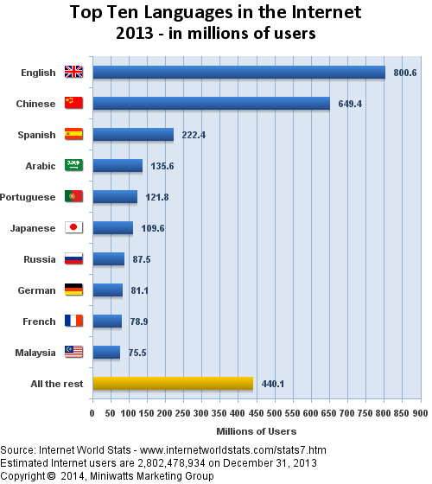
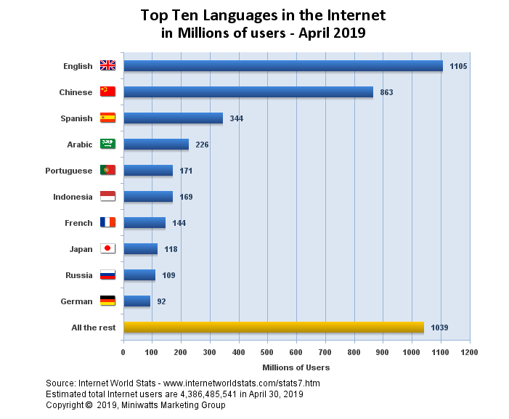
Multilingualism in the cyberspace / Multilingüismo en el ciberespacio
Los 10 más usados en Internet, 2019
Los 10 más usados en Internet, 2019
Notes:
Despite technological progress achieved, many users of minority, less-used and indigenous languages still experience a variety of barriers to access information in cyberspace, access websites and e-content, use the domain name system, mobile phones and applications, television, personal computers, tables and other in their own languages at school, workplace or public domain.
As it can be seen from the graphs, the content of the internet is still 50% in English language and therefore inaccessible for these groups. This proportion markedly contrasts with the number of languages spoken offline. Additionally, the six official languages of the United Nations (Arabic, Chinese, English, French, Russian and Spanish) are all included in the above Top Ten Internet languages table.
Since 2011, UNESCO has collaborated with EURid to produce the World Report on Internationalized Domain Names, with the support of Verisign and the regional ccTLD organisations. Internationalized domain names (IDNs) have a great potential to increase linguistic diversity in the cyberspace, as they are particularly suited to support indigenous scripts and evidence shows that they are used locally. However, IDNs occupy only 2% of domain name space, and there is still technical work to do. Yet, private-sector organizations are increasingly supporting multilingualism by shifting their focus from languages ranked according to countries with the highest GDP, to developing language technologies in multiple languages, including minority ones.

Slide 19
Current realities - transformative period : from special to mainstream, cheaper products and personalized services
Realidades actuales - período transformador: desde productos especiales o de moda, productos más baratos y servicios personalizados
Shop assistant in Paris, France.
Images: Planning smart and accessible public spaces in cities
https://img2.grazia.fr/var/grazia/storage/images/article/uniqlo-ouvre-un-magasin-connecte-et-dote-d-un-robot-a-paris-833330/13509206-1-fre-FR/Uniqlo-ouvre-un-magasin-connecte-et-dote-d-un-robot-a-Paris_exact1900x908_l.jpg
Notes:
In the contemporary globalized world, we see an increasing move towards personalized services and products.
While with the advent of consumerism production focused on mainstream, generic and cheap products, nowadays there is a tendency to costumise and personalise products according to individual preferences and needs. In this respect, languages should be integrated in the process. UNESCO strongly supports the development of multilingual digital content and services, in line with the 2003 Recommendation.

Slide 20
Beyond being communication systems, local knowledge systems, and cultural heritage, languages are also strategic national, regional and global resources.
Más allá de sistemas de comunicación, sistemas de conocimiento local y patrimonio cultural, los idiomas también son recursos estratégicos nacionales, regionales y globales.
Notes:
The key message at the core of the IYIL2019 is that indigenous languages matter for peace-building, sustainable development, and reconciliation in our societies.
Let us think about the role of language for individuals as well as for society as a whole. Beyond being communication systems, local knowledge systems, and part of human heritage:
Languages are strategic regional/national resource. Having access to information, health, employment and public services in languages that people can understand contributes to the drastic improvement of people’s quality of life, finding a professional occupation, and participating in society at large.
Languages are essential enablers and strategic national assets that allow their users to: (i) express unique modes of thinking and expression, (ii) store and put into practice their rich knowledge-systems, (iii) articulate their individual and collective political claims, (iv) engage in constructive dialogue and facilitate conflict resolution.

Slide 21
What is UNESCO’s approach?
¿Cuál es el enfoque de la UNESCO?
Notes:
Normative framework
Marco normativo

Slide 22
UNESCO’s approach / Enfoque de la UNESCO
Sociedades del conocimiento
Educación
para todos
Diversitad
Cultural y
Linguistica
Acceso a la
Información y
Conocimiento
Libertad
de
Expresión
Datos
Información
Conocimiento
Acceso
Preservación
Creación
Diseminación
Pluralismo Inclusión Diversidad Apertura Participación
Human Need sand Rights
Necesidades humanas
Derechos humanos

Slide 23
Working modalities / Modalidades de trabajo
Normative instruments
Research
International cooperation
Special initiatives
Capacity building
Monitoring
Content creation
Awareness raising
Language technology

Slide 24
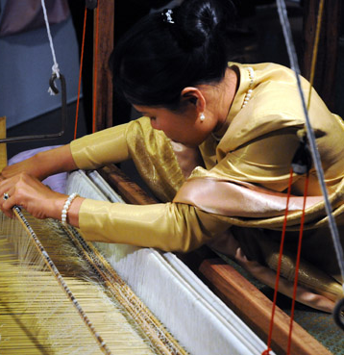
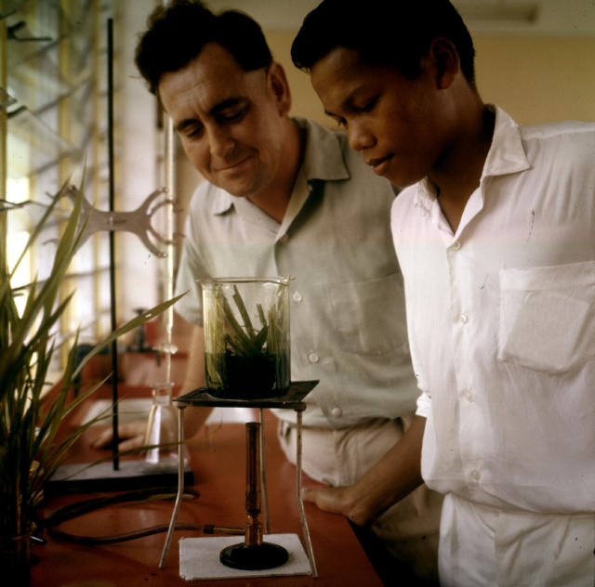
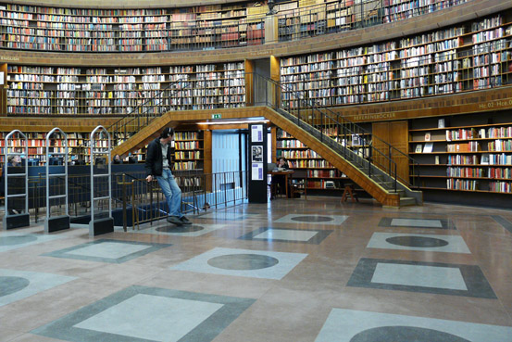
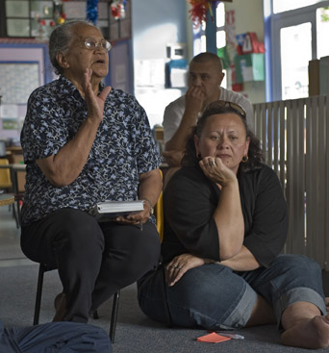
Shift of paradigm from
endangerment, documentation and protection
to sustainability and empowerment
Languages play a critical role in all spheres of personal, cultural, scientific, political and economic life
Michel Ravassard, © UNESCO
Jack Ling, © UNESCO
Cambio de paradigma del peligro, documentación y protección
a la sostenibilidad y el empoderamiento
Las lenguas desempeñan un papel fundamental en todos los ámbitos de la vida personal, cultural, científica, política y económica
Raul Delongaro, © UNESCO
Jocelyn Carlin, © UNESCO
Notes:
In the past language policies as well as researchers throughout the world – despite considerable differences in the models and approaches adopted by the respective countries – have tended to conceive language issues as purely cultural and educational ones. These are usually dealt with by organizations and centers for cultural memory and harmonization, or language development institutes.
Different language endangerment situations require for diverse solutions, measure and interventions. One size does not fit all.
There is increasing awareness that languages are repositories of diversity and complex systems of knowledge accumulated and transmitted over thousands of years, imbued with the history, memory, traditional knowledge, unique modes of thinking and expressions of the people who speak them.
In view of this, there is not only an imperative need for language documentation and preservation, but also to make efforts to ensure language revitalization via the elaboration of new tools, research directions, policy initiatives, etc. We must build support for language communities in their efforts to establish meaningful new roles for their endangered languages.
There is a need to further appreciate that Languages contribute to human development, and are essential to realizing sustainable development, good governance, peace and reconciliation.

Slide 25
How to place indigenous languages on the global development agenda?
Let’s make indigenous languages famous
¿Cómo colocar las lenguas indígenas en la agenda de desarrollo global?
Hagamos famosas las lenguas indígenas
Notes:
Let‘s first look some inspiring stories or good examples...

Slide 26
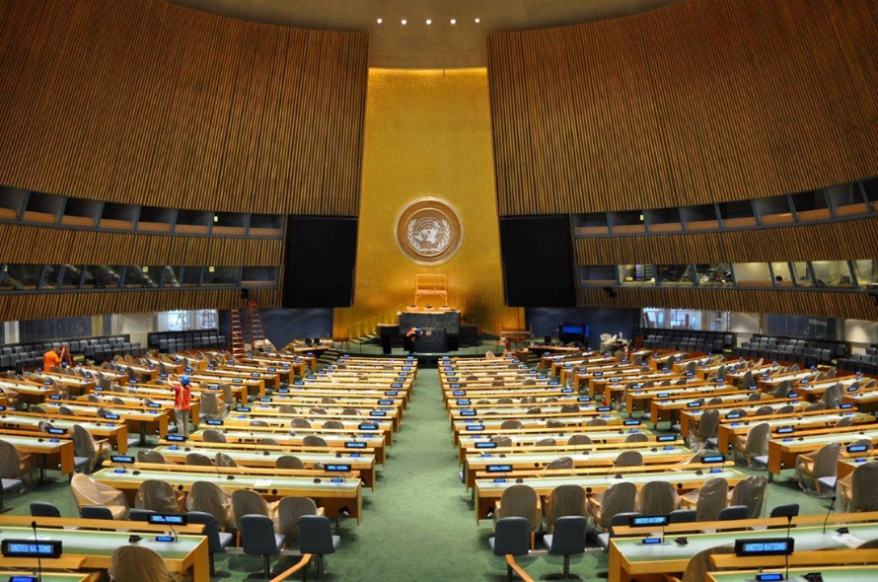
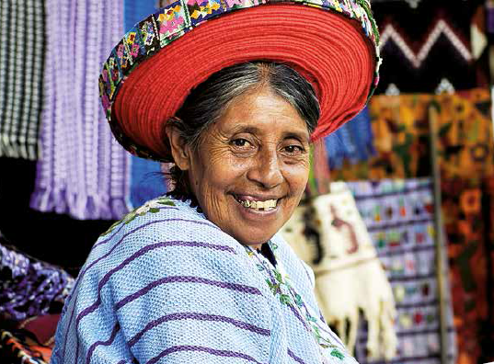
From the International Year of Indigenous Languages (2019) to the International Decade (+2022-2032) Del Año Internacional de las Lenguas Indígenas (2019) al Decenio Internacional (+2022-2032)
Notes:
The state of the world’s indigenous languages is critical, since it is estimated that there are between 6,000 and 7,000 oral languages in the world today, most of them spoken by very few individuals. The Forum recommends the adoption of a rights-based approach towards IL issues that considers the full spectrum of human rights and fundamental freedoms in accordance with the Declaration.
With the aim of raising awareness about the potential of these languages 2019 was declared the International Year of IL through a UNGA resolution, requesting UNESCO to act as lead organization
Concrete achievements have been made and impact is :
Changes in legislative landscape encouraging governments to take urgent measures to support indigenous languages.
Encouragement for many indigenous peoples to continue learning their languages, developing new training materials and sharing traditional knowledge to younger generations.
Providing significant conceptual insights for future actions by researchers from 63 countries
Raising awareness by the International Year by 200 media organizations from 109 countries.
Social media campaigns that introduced a new tide of global engagement for audiences of digital generations
Regional and international consultations to identify recommendations for future actions, integrated in the Strategic Outcome Document
The International Day of Mother Tongue and the International Day of the World’s Indigenous Peoples greatly contributed to promotion of IYIL2019

Slide 27
Main objectives
Objetivos principales
The International Year is an important means of international cooperation to raise global awareness of indigenous languages and to mobilize different stakeholders and resources for coordinated action around the world by:
Focusing global attention on the critical risks confronting indigenous languages and its significance for sustainable development, reconciliation, good governance and peacebuilding,
Targeting steps which will lead to improved quality of life, enhanced international cooperation and strengthened intercultural dialogue, and reaffirming cultural and linguistic continuity, and
Delivering increased capacities on the part of all stakeholders to take concrete and sustainable measures at every level to support, access and promote indigenous languages around the world in accordance with the legitimate rights of indigenous peoples.
El Año Internacional es un medio importante de cooperación internacional para aumentar la conciencia mundial sobre las lenguas indígenas y para movilizar a diferentes partes interesadas y recursos para una acción coordinada en todo el mundo mediante:
Centrar la atención mundial en los riesgos críticos que enfrentan las lenguas indígenas y su importancia para el desarrollo sostenible, la reconciliación, la buena gobernanza y la consolidación de la paz,
Orientar los pasos que conducirán a una mejor calidad de vida, una mayor cooperación internacional y un diálogo intercultural fortalecido, y reafirmar la continuidad cultural y lingüística, y
Brindar mayores capacidades por parte de todos los interesados ​​para tomar medidas concretas y sostenibles en todos los niveles para apoyar, acceder y promover las lenguas indígenas en todo el mundo de acuerdo con los derechos legítimos de los pueblos indígenas.

Slide 28
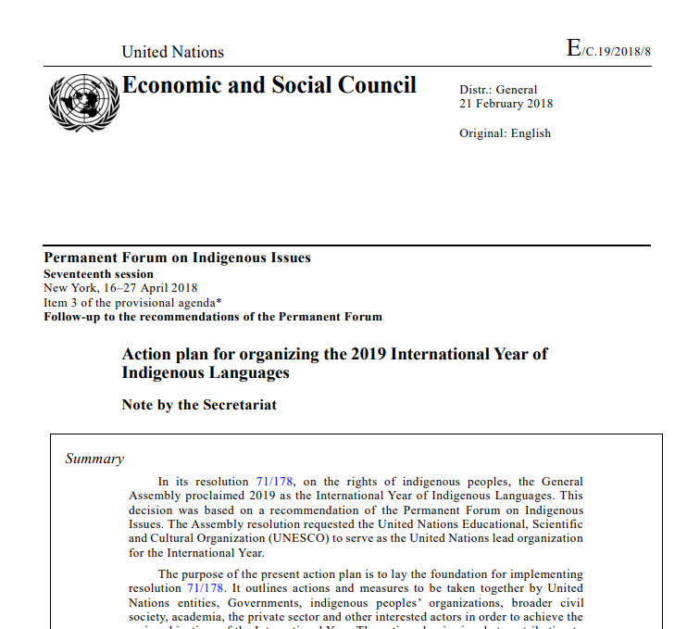
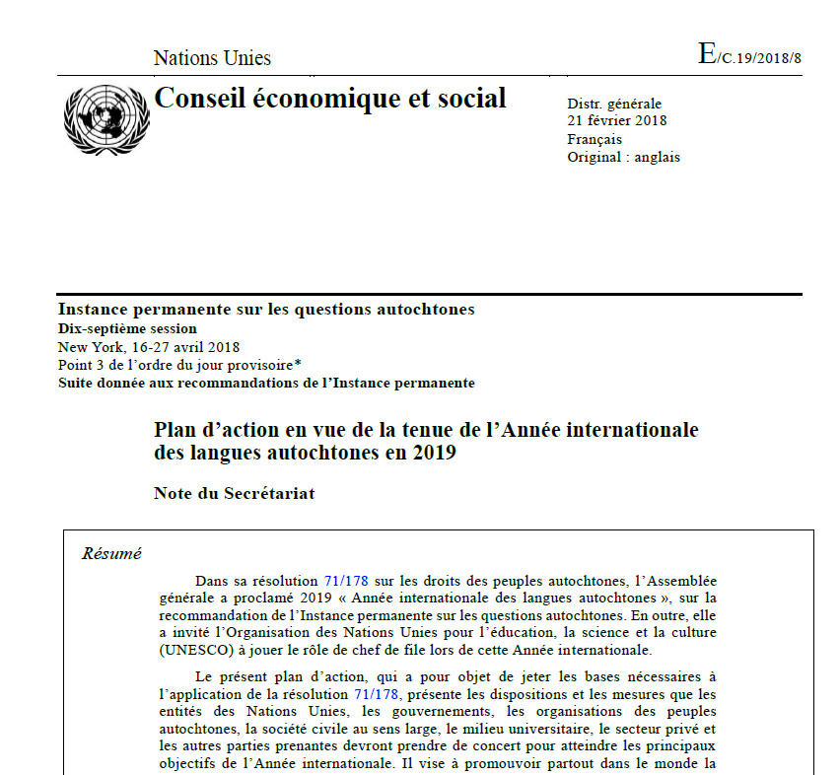
International consultations towards global actions
Consultas internacionales hacia acciones globales
Consultative meetings in 2017
Réunions consultatives en 2017
Global Action Plan 2018-2020
Plan de Acción Mundial 2018-2020
UN Permanent Forum (PFII), 16th session;
Foro Permanente de Naciones (PFII), 16º período de sesiones;
Expert Mechanism on the Rights of Indigenous Peoples meeting;
Reunión del Mecanismo de Expertos sobre las Drogas de los Pueblos Indígenas;
First multi-stakeholder meeting to elaborate the draft Action Plan;
Un reencuentro de varias partes para elaborar un plan de acción del proyecto;
Review process 2018;
Evaluación de procesos y 2018;
UN Permanent Forum on Indigenous Issues, 17th session.
Foro Permanente de Sindicatos de Naciones (PFII), 17º período de sesiones.
Notes:
in New York organized last May during the 16th session of the Permanent Forum (PFII);
in Geneva, the open consultations during the Expert Mechanism on the Rights of Indigenous Peoples meeting (EMRIP);
in Paris at UNESCO Headquarters, a first multi-stakeholder meeting to elaborate the draft Action Plan; and
Review process launched from December 2017 to February 2018.
Presentation of the Action Plan at the UN Permanent Forum on Indigenous Issues in April 2018.

Slide 29
Key principles
Principios claves
Human-rights
Derechos humanos
Focus on indigenous peoples
Centrarse en los pueblos indígenas
International standards
Normas internacionales
Joint action
Acción conjunta
Multi-stakeholderism
Múltiples partes interesadas
Holistic approach
Enfoque holístico
Synergy among partners
Sinergias entre las partes

Slide 30
3 thematic areas for joint action
3 áreas temáticas para la acción conjunta
Indigenous languages matter for social, economic, political development, peaceful coexistence and reconciliation in our societies
Las lenguas indígenas son importantes para el desarrollo social, económico, político, la convivencia pacífica y la reconciliación en nuestras sociedades.
SUPPORT. Revitalization and maintenance of indigenous languages through a range of different measures
ACCESS. Preservation of indigenous languages, access to education, information and knowledge, improvement of data collection and sharing of information, using technology and other means
PROMOTION. Maintenance of the knowledge and values of indigenous languages and cultures within broader sociocultural, economic and political domains
APOYO. Revitalización y mantenimiento de lenguas indígenas a través de una gama de diferentes medidas.
ACCESO. Preservación de las lenguas indígenas, acceso a la educación, la información y el conocimiento, mejora de la recopilación de datos y el intercambio de información, utilizando tecnología y otros medios.
PROMOCIÓN. Mantener el conocimiento y los valores de las lenguas y culturas indígenas dentro de dominios socioculturales, económicos y políticos más amplios.

Slide 31
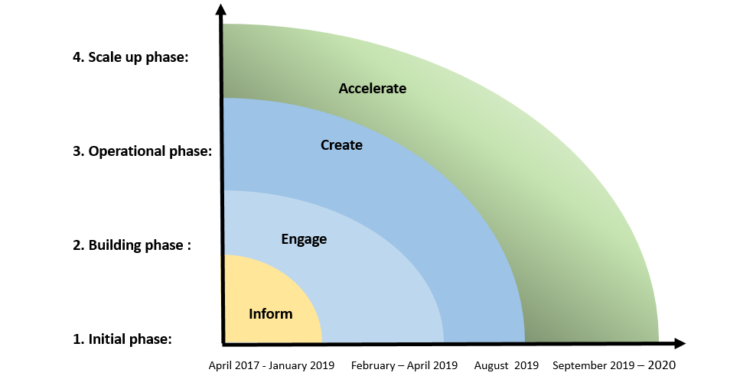
The implementation of the communication strategy will be divided into four phases, and if needed, adapted to new opportunities:
La implementación de la estrategia de comunicación se dividirá en cuatro fases y, si es necesario, se adaptará a las nuevas oportunidades:
4. Fase de ensamblaje y puvancia
3ra fase operacional
2. Fase de construcción
1. Fase inicial
Acelerar
Crear
Comprometer
Informar

Slide 32
Global Communication Strategy
Website
Hashtags
Social media
Logo guidalines
Digital content
Calendor of Events
Estrategia de comunicación global
Sitio web
Hashtags
Redes sociales
La directriz del uso del logo
Contenido digital
Calendario de eventos

Slide 33
Internal information management system
Sistema interno de gestión de la información
Users’ space
Espacio de los usuarios
Add new event / logo request
Agregar nuevo evento / solicitud de logotipo
My IYIL2019
Add new resource /
Agregar nuevo recurso /
Chat room
Sala de chat

Slide 34
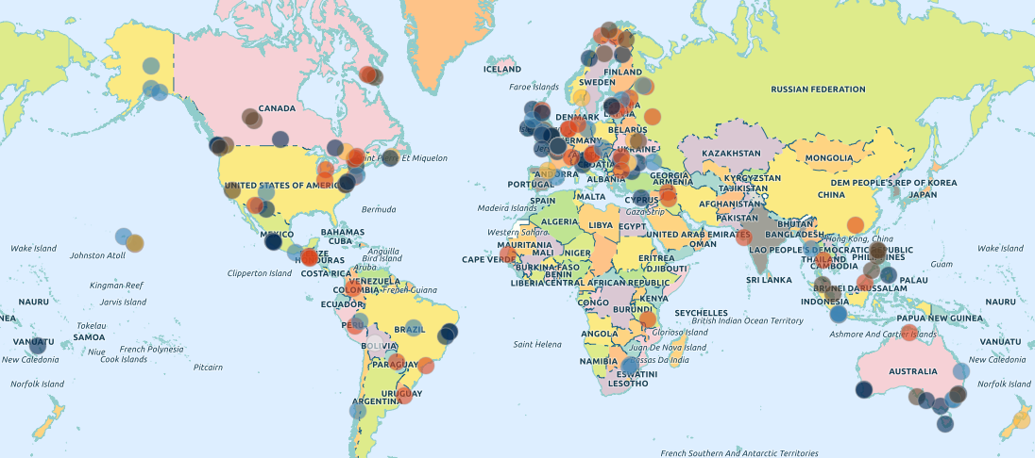
Global calendar of events
Calendario global de eventos

Slide 35
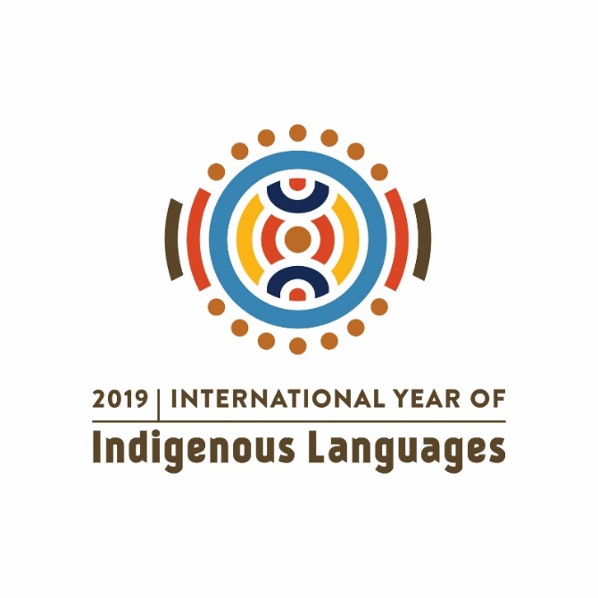
882 events created in total 372 logo requests have been approved 124 not granted (January 2020)
882 eventos creados en total
372 solicitudes del uso del logotipo
124 no concedidas
(enero de 2020)

Slide 36
78 countries reported events and activities.
The total number of countries from which research papers were uploaded was 63.
Combined the two lists for the two principal forms of activity, 94 countries.
78 países informaron de eventos y actividades.
El número total de países desde los que se compartieron los trabajos de investigación fue de 63.
Combinó las dos listas para las dos formas principales de actividad, 94 países.

Slide 37
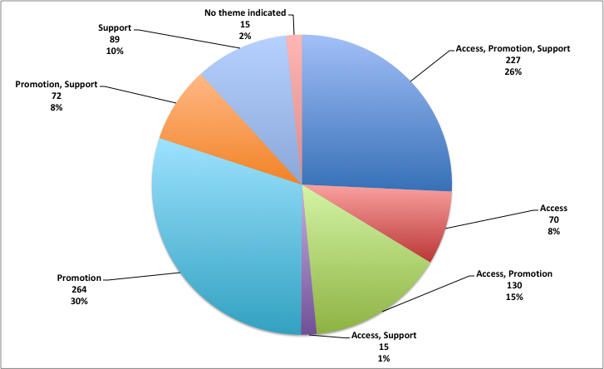
882 activities by thematic area
882 actividades por área temática
Acceso, promoción, apoyo | 227
Acceso | 70
Acceso, promoción | 130
Acceso, apoyo | 15
promoción | 264
promoción, apoyo | 72
apoyo | 89
No indicado | 15
TOTAL | 882

Slide 38
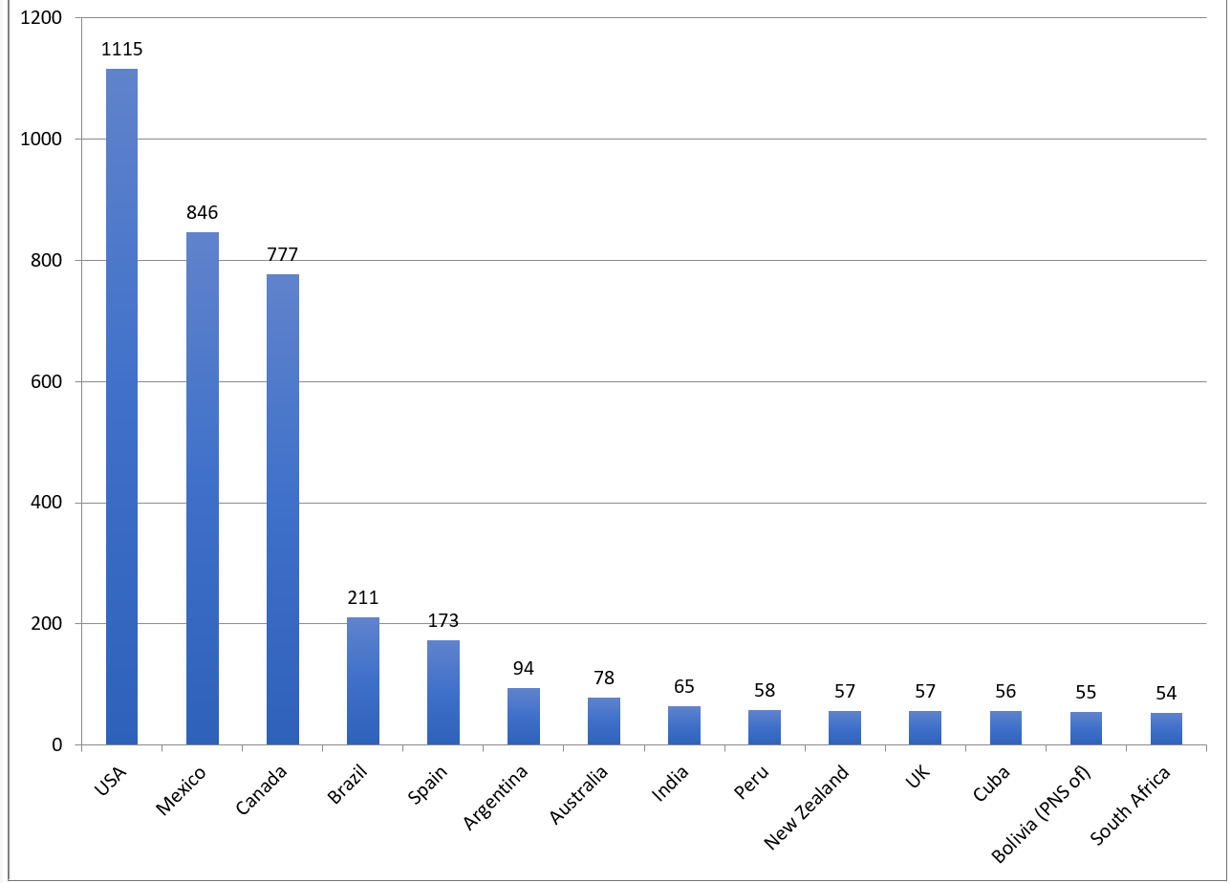
Global Media Coverage (4621 articles, 245 media organizations from 109 countries)
Cobertura global de medios
(4621 artículos, 245 organizaciones de medios de 109 países)

Slide 39
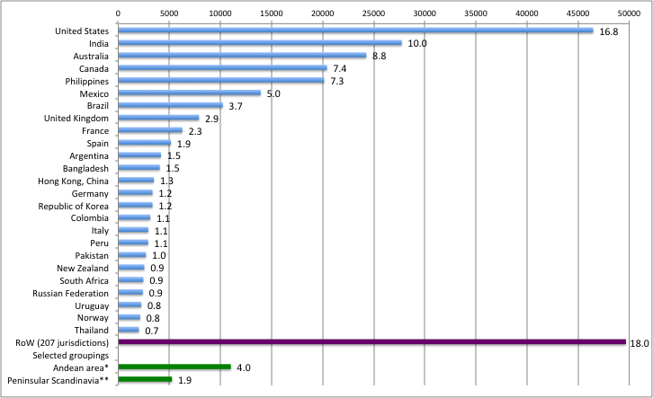
Top 25 countries of unique visitors by country of location
Los 25 principales países de visitantes únicos por país de ubicación

Slide 40
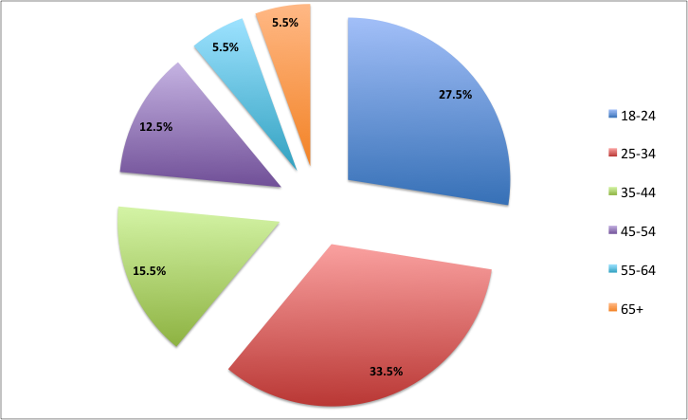
Age distribution of visitors on the IYIL 2019 web site through end-January 2020
Distribución por edad en visitantes del sitio web AILA2019 hasta fines de enero de 2020

Slide 41
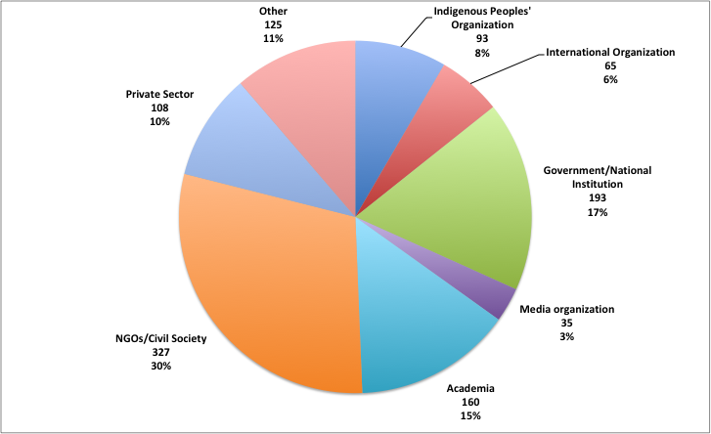
Distribution of users by reported organisation type (website)
Distribución de usuarios por tipo de organización informada (sitio web)

Slide 42
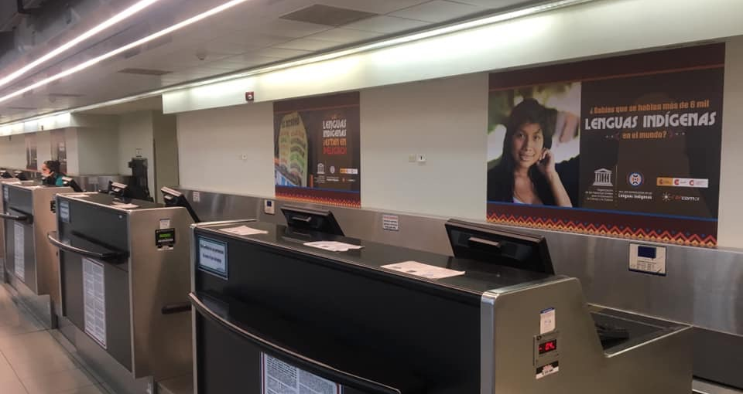
Advocacy campaign in the international airport of San Jose for the IYIL2019 / Campaña de promoción en el aeropuerto internacional de San José para el AILA2019

Slide 43
16 post stamps issued to commemorate the IYIL2019
16 timbres postales emitidos para conmemorar el AILI2019
An IYI2019 stamp was designed and circulated by many national postal authorities. This work was done in cooperation with the Universal Postal Union (UPU) which actively promoted the global campaign and encouraged national postal offices to raise awareness about the IYIL2019.
The IYIL2019 stamp was produced by UN Stamps and The Guernsey Stamps and Collectables. The following countries also produced and circulated the IYIL2019 stamp: Australia, Belarus, Chili, Spain, France, Denmark, Guinee, Italy, North Macedonia, Peru, the Philippines, Syria and Tunisia.
Un timbre AICI2019 fue diseñado y distribuido por muchas autoridades postales nacionales. Este trabajo se realizó en cooperación con la Unión Postal Universal (UPU), que promovió activamente la campaña mundial y alentó a las oficinas postales nacionales a crear conciencia sobre el AILI2019.
El timbre AILI2019 fue producido por UN Stamps y The Guernsey Stamps and Collectables. Los siguientes países también produjeron y distribuyeron el sello IYIL2019: Australia, Bielorrusia, Chile, España, Francia, Dinamarca, Guinea, Italia, Macedonia del Norte, Perú, Filipinas, Siria y Túnez.

Slide 44
Call for Research Papers / Convocatoria para trabajos de investigación
1. Humanitarian affairs, peace-building and national development plans (e.g. during and post-conflict period, radicalization and other; assimilation, mapping and revitalization policies related to languages);
2. Indigenous education and life-long learning;
3. Indigenous knowledge in science and health (including interventions for epidemic or pandemic diseases; activism for climate change; water, bioethics and other);
4. Gender equality (e.g. reproductive health education policies, role of indigenous women in intergenerational transmission);
5. Social inclusion and urbanization, ethics and civic engagement (e.g. recognition of sign languages, youth engagement, open solutions and other issues);
6. Cultural heritage and diplomacy (concept of equality of languages, cultural identity imbued in languages);
7. Technology, digital activism, and artificial intelligence (e.g. language technology);
1. Asuntos humanitarios, construcción de paz y planes nacionales de desarrollo (por ejemplo, durante y después del conflicto, radicalización y otros; políticas de asimilación, mapeo y revitalización relacionadas con los idiomas)
2. Educación indígena y aprendizaje permanente;
3. Conocimiento indígena en ciencia y salud (incluidas intervenciones para enfermedades epidémicas o pandémicas;
activismo por el cambio climático; agua, bioética y otros);
4. Igualdad de género (por ejemplo, políticas de educación en salud reproductiva, papel de las mujeres indígenas en la transmisión intergeneracional);
5. Inclusión social y urbanización, ética y compromiso cívico (por ejemplo, reconocimiento de lenguajes de señas, compromiso juvenil, soluciones abiertas y otros temas);
6. Patrimonio cultural y diplomacia (concepto de igualdad de idiomas, identidad cultural imbuida en idiomas);
7. Tecnología, activismo digital e inteligencia artificial (por ejemplo, tecnología del lenguaje);
Notes:
UNESCO Launched a Call for Research Papers within the framework of the International Year of Indigenous Languages 2019, calling for the joint action of researchers and practitioners in order to put its message across and have an impact on the way in which indigenous languages are conceived, and their value appreciated by multiple stakeholders – governments, broader civil society, academia, the private sector and other actors.
7 themes/subject areas were suggested for submissions, in line with the Action Plan for the Implementation of the International Year of Indigenous Languages 2019.

Slide 45
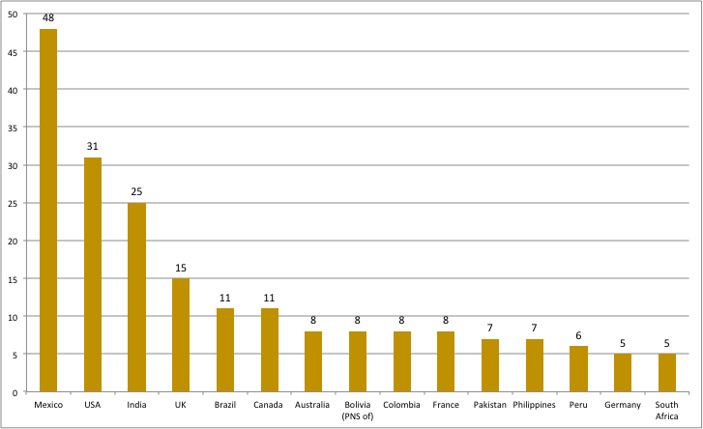
Geography of the IYIL research activity - scientific research activity (284) related to IYIL 2019 has involved 63 countries.
Geografía de la actividad de investigación AILI2019: la actividad de investigación científica (284) relacionada con AILI2019 ha involucrado a 63 países.

Slide 46
Recent events / Eventos recientes

Slide 47
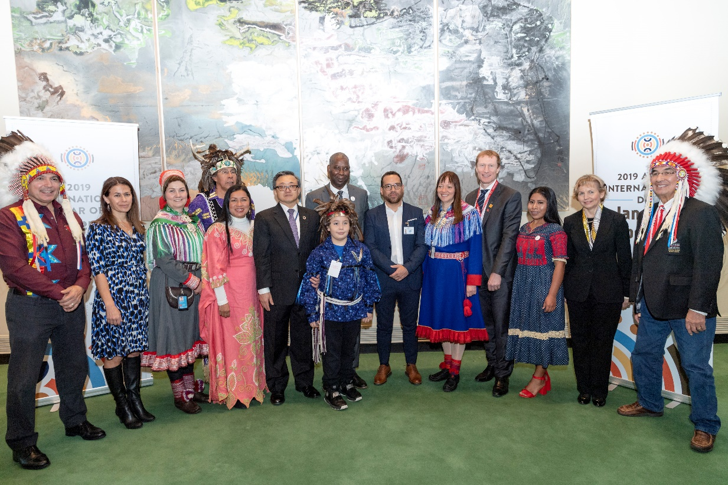
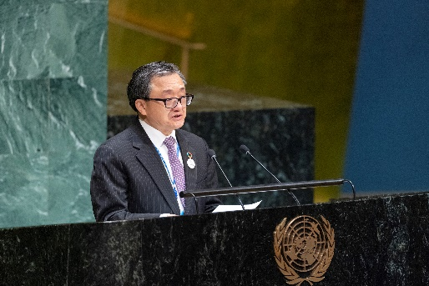
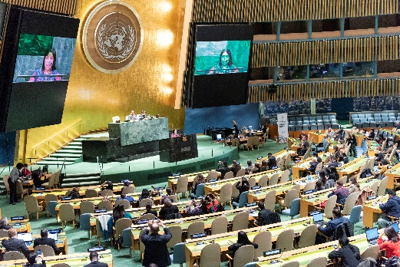
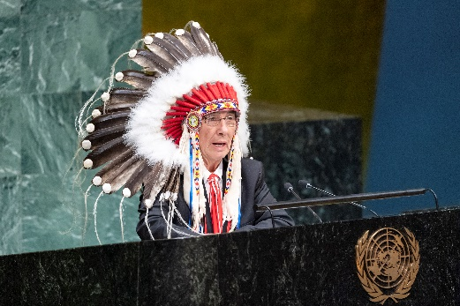
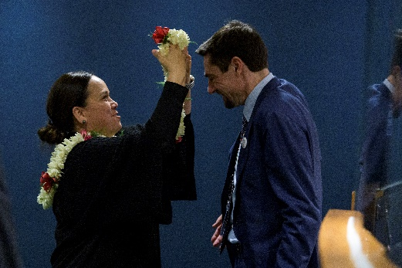
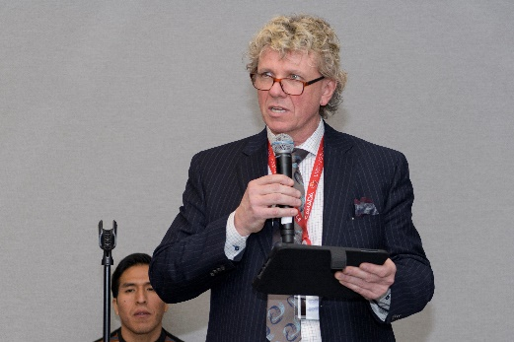
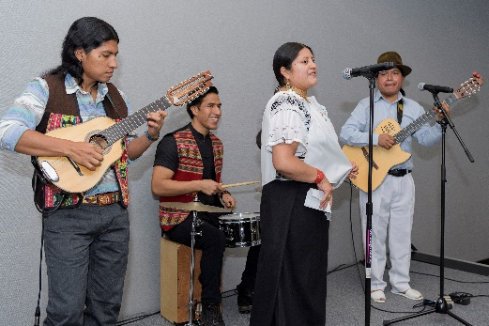
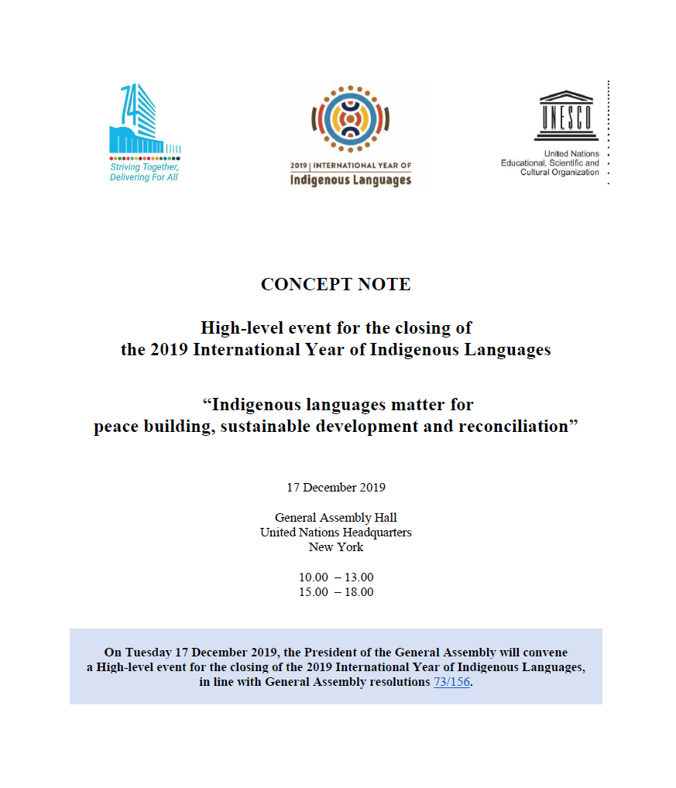
The High Level closing event at UNGA in New York took place on 17 December 2019
El evento de clausura de alto nivel en la AGNU en Nueva York tuvo lugar el 17 de diciembre de 2019
47 speakers from representing Member States, indigenous representatives from socio-cultural regions, and other UN and other public partners.
47 oradores de representantes de los Estados miembros, representantes indígenas de regiones socioculturales y otros socios públicos de la ONU y otros.
https://www.un.org/pga/74/event/high-level-event-for-the-closing-of-the-2019-international-year-of-indigenous-languages/

Slide 48
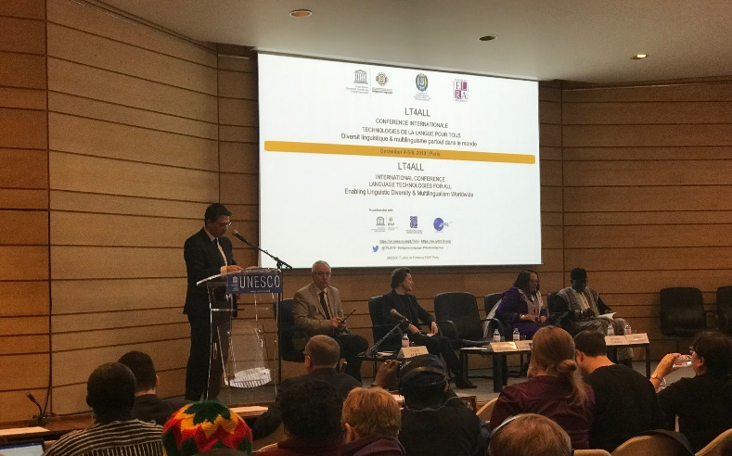
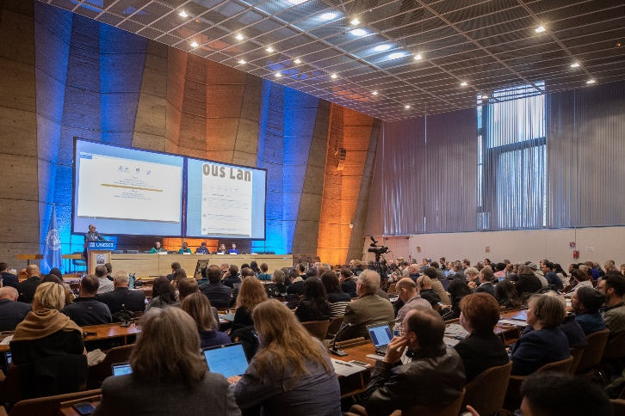
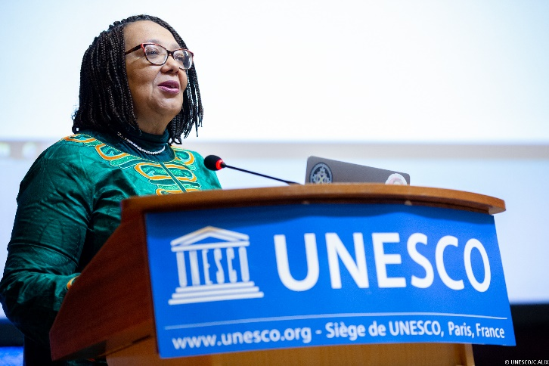
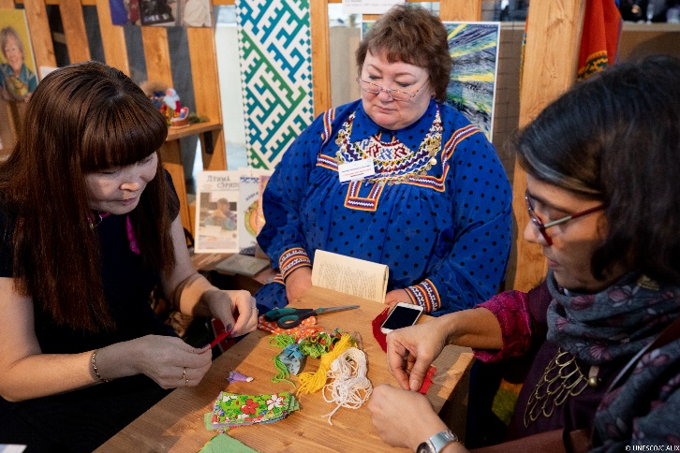
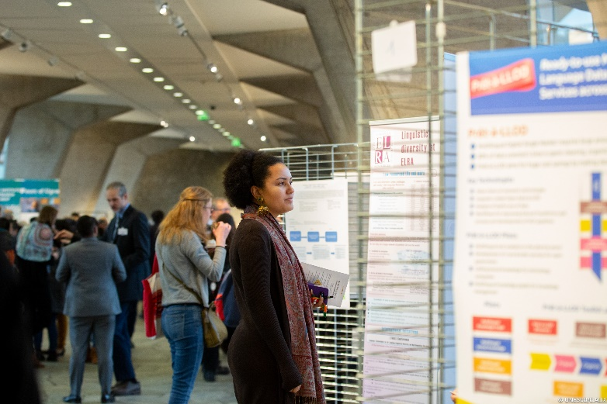
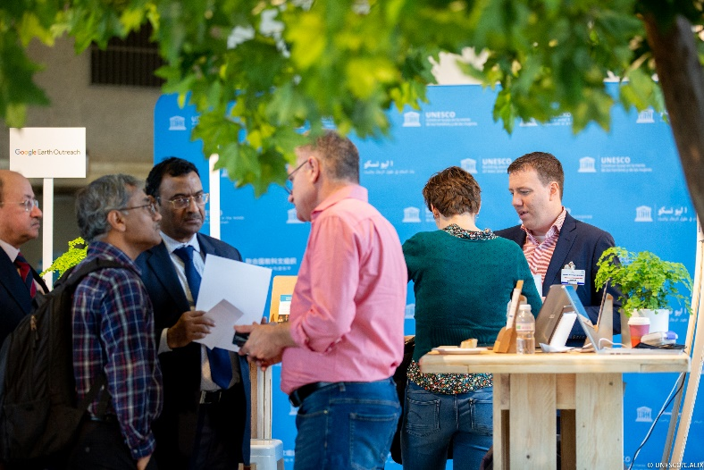
The International Conference Language Technology for All: Enabling Linguistic Diversity and Multilingualism” at UNESCO Headquarters on 4-6 December 2019
La Conferencia Internacional Tecnología de idiomas para Todos: Habilitación de la diversidad lingüística y el multilingüismo" en la Sede de la UNESCO los días 4 y 6 de diciembre de 2019

Slide 49
Conceptual framework towards the Outcome Document – Los Pinos Declaration
Marco conceptual hacia el Documento Final - Declaración de Los Pinos
Regional approach (1 session) :
Engaging with Indigenous Peoples’ through Regional Mechanisms
Stakeholder approach (1 session):
Building Coordination Mechanism for the IDIL2022-2032
Financial approach (1 session):
Multi-donor Financial Mechanism
Thematic approach (6 sessions):
Inclusive and Equitable Education and Learning Environments for Promoting Indigenous Languages
Indigenous Languages in Justice and Public Services
Digital Empowerment, Language Technology and Indigenous Media
Protection and Safeguarding Cultural and Linguistic Heritage
Indigenous Languages, Climate Change and Biodiversity
Indigenous Languages for Better Health, Social Cohesion and Humanitarian Response
Enfoque regional (1 sesión):
Comprometerse con los pueblos indígenas a través de mecanismos regionales
Enfoque de las partes interesadas (1 sesión):
Mecanismo de coordinación para el Decenio 2022-2032
Enfoque financiero (1 sesión):
Mecanismo financiero de donantes múltiples
Enfoque temático (6 sesiones):
Entornos de educación y aprendizaje inclusivos y equitativos para promover las lenguas indígenas
Lenguas indígenas en impartición de justicia y servicios públicos
Empoderamiento digital, tecnología del lenguaje y medios indígenas
Protección y salvaguarda del patrimonio cultural y lingüístico.
Lenguas indígenas, cambio climático y biodiversidad
Lenguas indígenas para una mejor salud, cohesión social y respuesta humanitaria

Slide 50
Strategic Outcome Document Documento de resultados estratégicos

Slide 51
Roadmap towards the Outcome Document of the IYIL2019 Hoja de ruta hacia el documento de resultados del AILI2019
Drafting Contribution Finalization Presentation Dissemination Redacción Contribución Finalización Presentación Difusión
REGIONAL OUTCOME DOCUMENTS and CONTRIBUTIONS
Paraguay
China
Ecuador
Canada
African Union
Peru
STRATEGIC OUTCOME DOCUMENT
OF THE 2019 INTERNATIONAL YEAR
OF INDIGENOUS LANGUAGES
PRELIMINARY IDEAS Side event UNPFII April 2019 and EMRIP July 2019
DRAFT DOCUMENT Steering Committee meetings June, July and October 2019
DRAFT DOCUMENT Open-ended drafting group June – August 2019
DRAFT DOCUMENT Open online consultations August – September 2019

Slide 52
Logical framework of the Strategic Outcome Document Marco lógico del Documento de Resultados Estratégicos
Rationale Fundamento
Conclusions Conclusiones
Future steps Pasos futuros
Immediate action Acción inmediata
Development
Human rights
Strategies
Empowerment
Progress
Synergy
Sustainability
Desarrollo
Derechos humanos
Estrategias
Empoderamiento
Progreso
Sinergia
Sostenibilidad
Goal Gol
Arguments Argumentos
Overarching strategic
Objective Estratégico saqueo
Objetivo
Global challenges
Human Rights
Multi-stakeholderism
Sustainability of actions
Framework
Theory of change
Global agenda
Progress
Strategic action
Desafíos globales
Derechos Humanos
Múltiples partes interesadas
Sostenibilidad de las acciones
Marco de referencia
Teoría del cambio
Agenda global
Progreso
Acción estratégica
Recommendations Recomendaciones
Insights Ideas
Suggested actions Acciones sugeridas

Slide 53
Roadmap towards the International Decade of Indigenous Languages and the integration of the needs of indigenous language users into the 2030 Agenda
Hoja de ruta hacia el Decenio Internacional de las Lenguas Indígenas
y la integración de las necesidades de los usuarios de lenguas indígenas en la Agenda 2030
2020 | 2021 | 2022 | 2023 | 2024 | 2025 | 2026 | 2027 | 2028 | 2029 | 2030 | 2031 | 2032/01
TRANSITION PERIOD PERÍODO DE TRANSICIÓN |  | SCALE UP PERIOD PERÍODO DE AMPLIACIÓN |  |  |  | MID TERM REVIEW REVISIÓN DE MEDIO TERMINO |  | STRATEGIC POSITIONING PERIOD PERÍODO DE POSICIONAMIENTO ESTRATÉGICO |  |  | INTEGRATION Integración
Notes:
As there are 10 years to go to achieve the set targets of the 2030 Agenda, the proclamation of a decade of indigenous languages, strongly supported by many stakeholders, becomes a global priority.
The IYIL2019 has highlighted the urgency to promote, protect and mainstream these languages at all levels. It has also taught us lessons to shape the future milestones for the International Decade, through the collection of good practices.
Built on valuable insights and successful initiatives, the International Decade should be aimed to implement appropriate language policies and legislative agendas, to further academic research and data collection, as well as developed and disseminated methodologies, programmes and technological solutions such as language technologies using Artificial Intelligence.
The two-days high-level event taking place over the course of the next two days will serve as forum to exchange views among a wide range of stakeholders and determine milestones in view of the upcoming decade.
To go back to the beginning of my presentation, let’s “think global, and act local”, engaging in in systematic and strategic efforts in all relevant areas and at every level, starting from the establishment of guidelines for the preparatory and transitional process of the upcoming International Decade, to the full integration of the needs of indigenous languages users in the 2030 SDGs Agenda.

Slide 54
“Leaving no one behind“ It is not only about languages, it is about people. People speaking and using indigenous languages should be recognized as national strategic assets who have the right to be protected, supported and empowered as much as everyone else.
"No dejar a nadie atrás"
No se trata de idiomas, se trata de personas.
Significa que las personas que hablan y usan lenguas indígenas deben ser reconocidas como un activo estratégico nacional que debe ser protegido, apoyado y fortalecido.
Notes:
Key message:
“Leaving no one behind“ It is not only about languages, it is about people.

