Slide 1
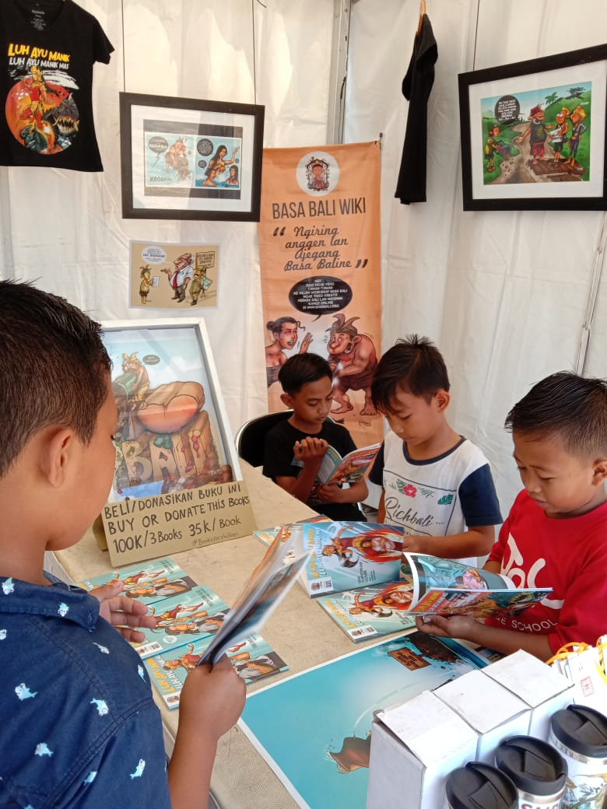
BASAbali
STRENGTHENING LANGUAGES
ENGAGING COMMUNITIES
BUILDING SCHOLARSHIP

Slide 2
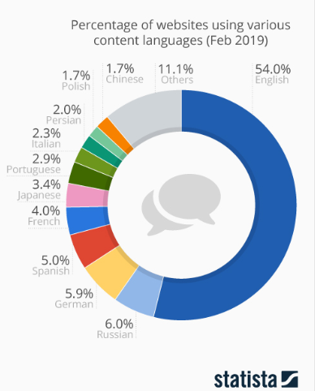

Slide 6
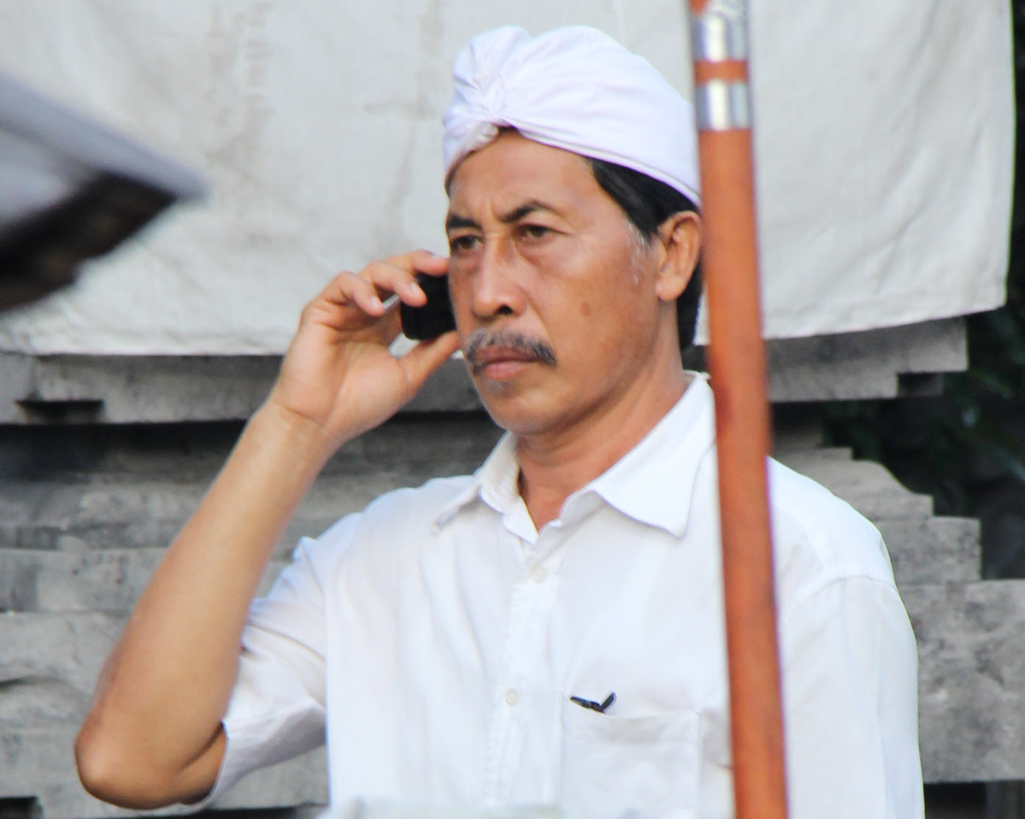

Slide 11
Intervene now
Mobilize locally
Value the local in the global
Make it easy, frequent and cool

Slide 12
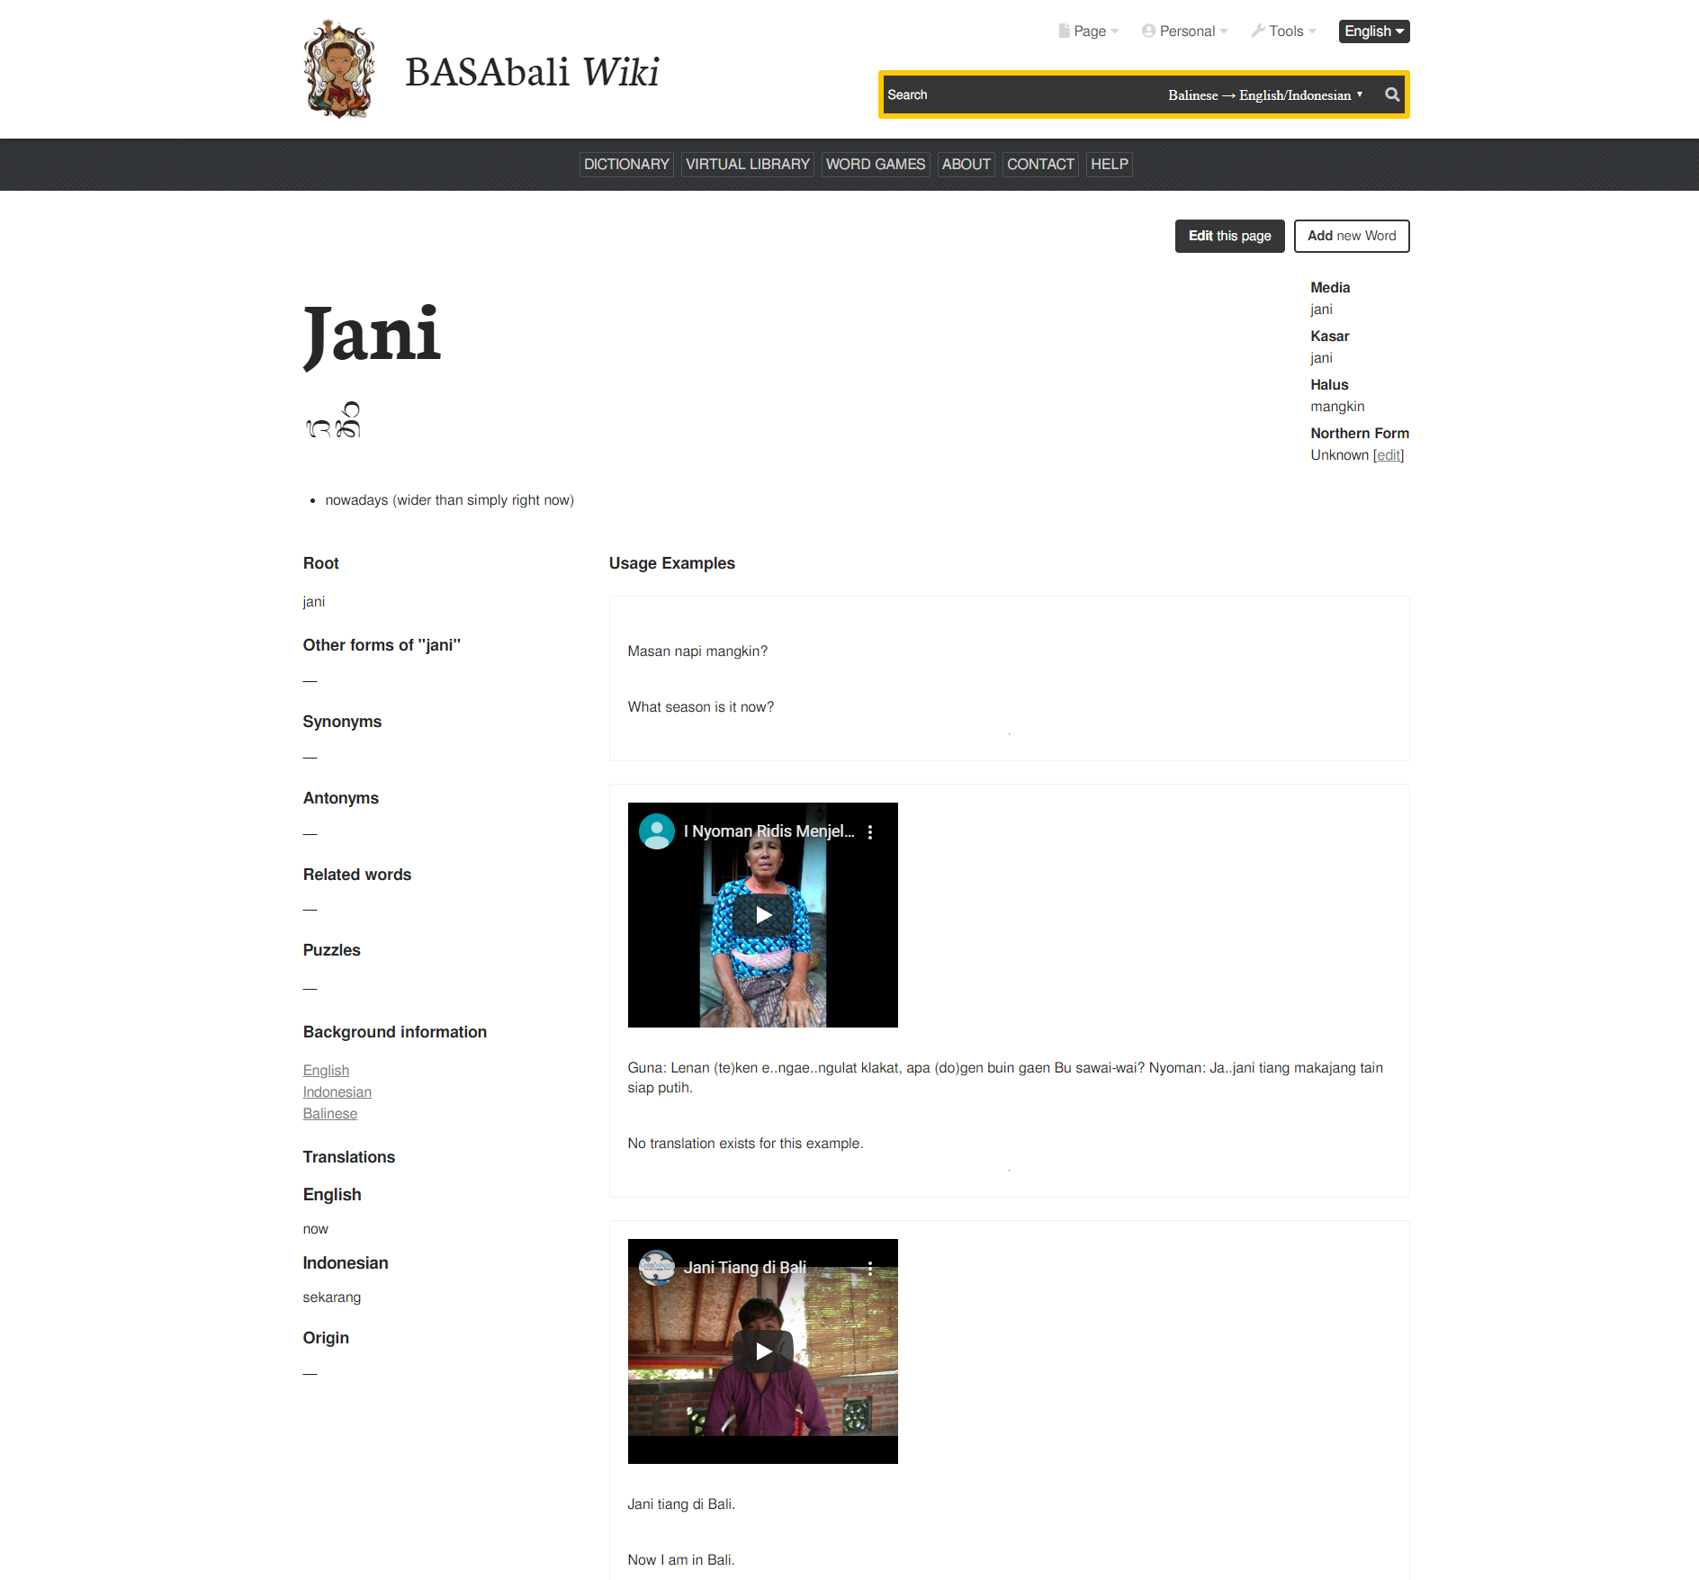

Slide 13
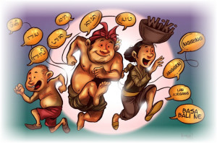
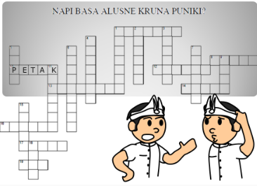

Slide 15
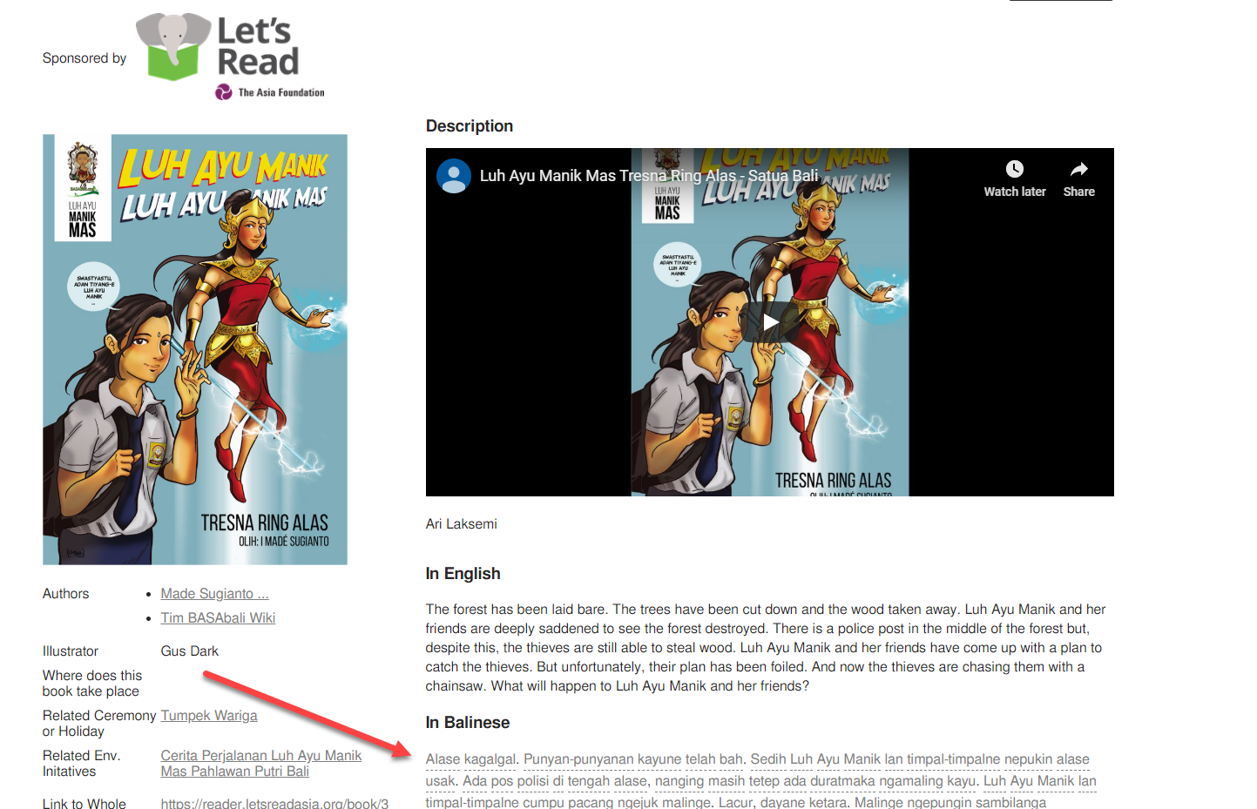

Slide 18
