Slide 1
(Indigenous) Language as a Human Right Kristen Carpenter and Alexey Tsykarev Mexico City 2020

Slide 2
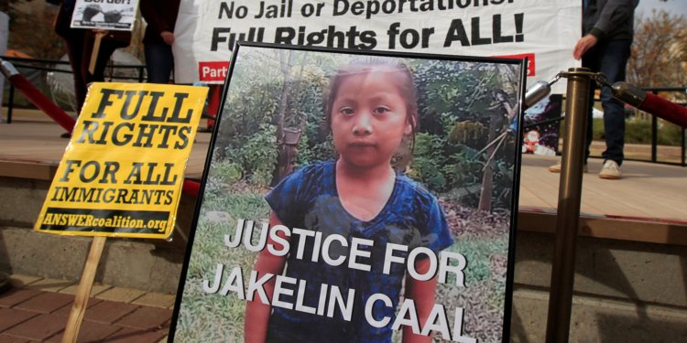
“It is unacceptable for any government agency to have persons in custody sign documents in a language that they clearly do not understand.” --Attorney for Nery Gilberto Caal Cuz, Jakelin’s father
Jakelin Caal Maquin (Kekhi Maya), age 7, died on Dec 8, 2019
in custody of U.S. border authorities

Slide 3
“If my language dies tomorrow then I am ready to die today“ (quoting the Avar poet Rasul Gamzatov)
Udmurt scholar Albert Razin died on September 10, 2019
protesting of Russia’s policies on indigenous, ethnic, and minority languages

Slide 4
Indigenous languages matter
for development, peace, governance and reconciliation
IYIL undertook "a human rights-based approach" to indigenous languages in which
"A person’s freedom to use one’s chosen language is a prerequisite to freedom of thought, freedom of opinion and expression, access to education and information, employment and other values enshrined in the Universal Declaration of Human Rights"

Slide 5
Among scholars of both law and linguistics
A human rights approach to indigenous language use, revitalization, and transmission has been criticized even by sympathetic voices (not to mention unsympathetic ones)
Law critiques: problems of efficacy | Linguistics critiques: problems of fit
Legal instruments are non-specific with respect to language rights Language rights have been poorly enforced in courts and tribunals Language needs are not universal (wide difference between individuals being discriminated against bc they don’t speak a majority language and individuals who seek to revitalize a dormant language) (how can any legal system accommodate this range?) | Language use is not question of (legal) rights but (social) attitudes “Anyone can learn a language” but they need motivation or incentive Traditionally linguists work on preservation and analysis, not use, revitalization, and transmission (some indigenous programs defy accepted linguistics methodologies) (community norms do not align with research standards & values)

Slide 6
Our view
These critiques from law and linguistics misapprehend three things: (1) what the international instruments actually say (2) what it means to “implement” human rights and (3) the situation of indigenous peoples’ languages from the perspective of self-determination
And that we need to articulate (indigenous) human rights approaches for #IDIL2022-2032

Slide 7
(1) What the instruments say & mean
Principles & Standards
ICCPR
ILO 169
Declaration on the Rights of Indigenous Peoples
Remedial & ongoing nature
Account for states’ roles in language loss & promote future language rights
Individual & Collective Rights
Not just individual access to majority language but collective survival of peoples
Linkage between language and other rights – life, health, child welfare, participation, land, culture, religion, development, treaties
Self-Determination
States have human rights obligations in this realm
That can only be fulfilled by working with indigenous peoples as leaders and partners

Slide 8
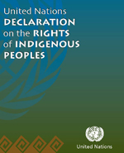
The right to revitalize, use, develop, and transmit
Article 13
Indigenous peoples have the right "to revitalize, use, develop and transmit" to future generations their histories, languages, oral traditions, philosophies, writing systems and literatures…
States shall take effective measures to ensure that this right is protected

Slide 9
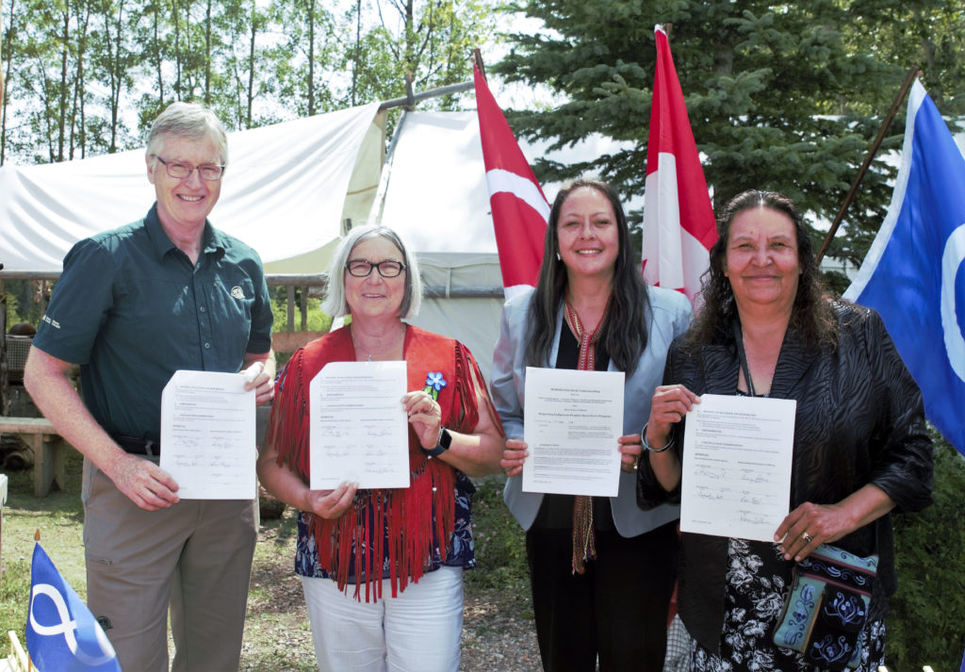
(2) Theorizing Implementation
Implementing human rights is not only about legal enforcement in courts or other tribunals
But also societal changes, awareness, cooperation, dialogue, and healing
Models: Pass laws to articulate baseline standards (comply with Declaration) with provision for mutual agreement between indigenous peoples and states to contextualize their situations

Slide 10
EMRIP Studies Language & Culture
Recommend States
Promote all indigenous languages
Provide sufficient funding to support teaching methods, literacy materials and orthographies in the pupil’s own languages
Enact national law and policy frameworks to support traditional & formal education … with the aim of developing and implementing appropriate programmes and activities for and by indigenous peoples.
Obtain indigenous peoples’ free, prior & informed consent when developing & implementing laws and policies related to indigenous peoples languages & culture
Notes:
2009 Study on lessons learned and challenges to achieve the right of indigenous peoples to education

Slide 11
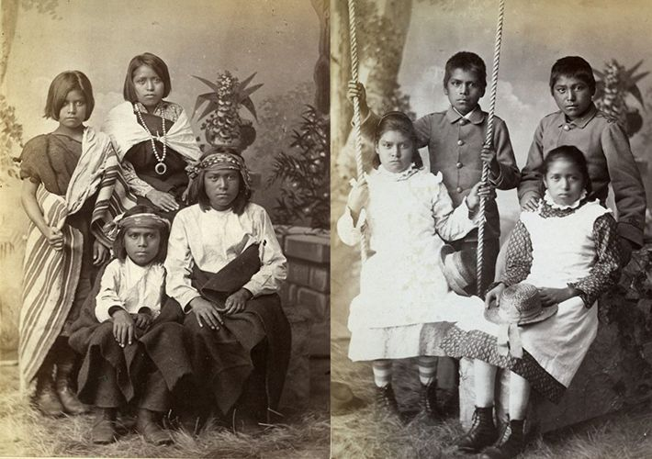
(3) Indigenous Perspectives: U.S. example

Slide 12
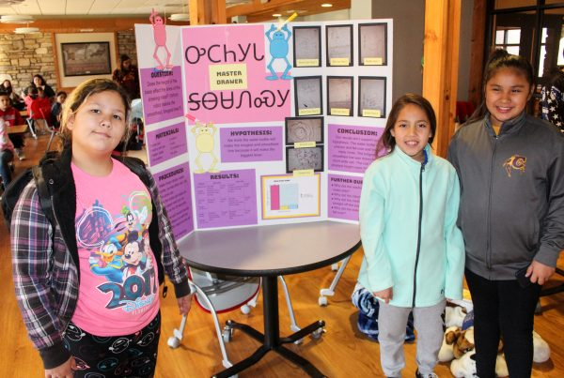
U.S. (National) Laws & (Indigenous) Contexts
Removal 1830s → ?
Assimilation 1850s-1934
Boarding Schools → 1970s
Voting Rights Act 1965
Indian Self-Determination & Education Act 1974
Native American Language Act 1990 & 1992
Esther Martinez Native American Languages Preservation Act of 2006-2020
Every Student Succeeds 2015
Immigration Issues 2020
Wampanoag Tribe
Native Hawaiians
Cherokee Nation
Navajo Nation
ROBOT: A fourth grade team from New Kituwah Academy poses with their science fair project.

Slide 13
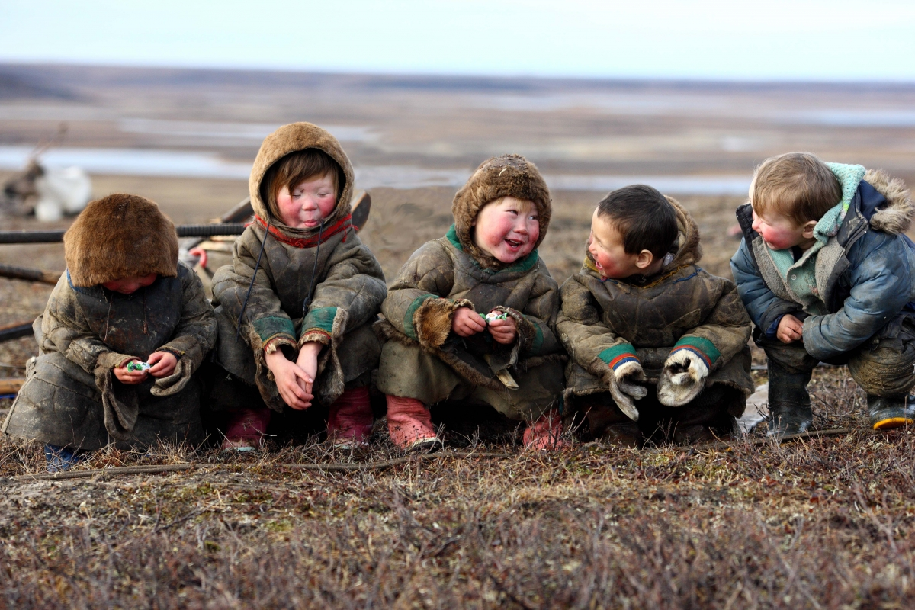
Russia

Slide 14
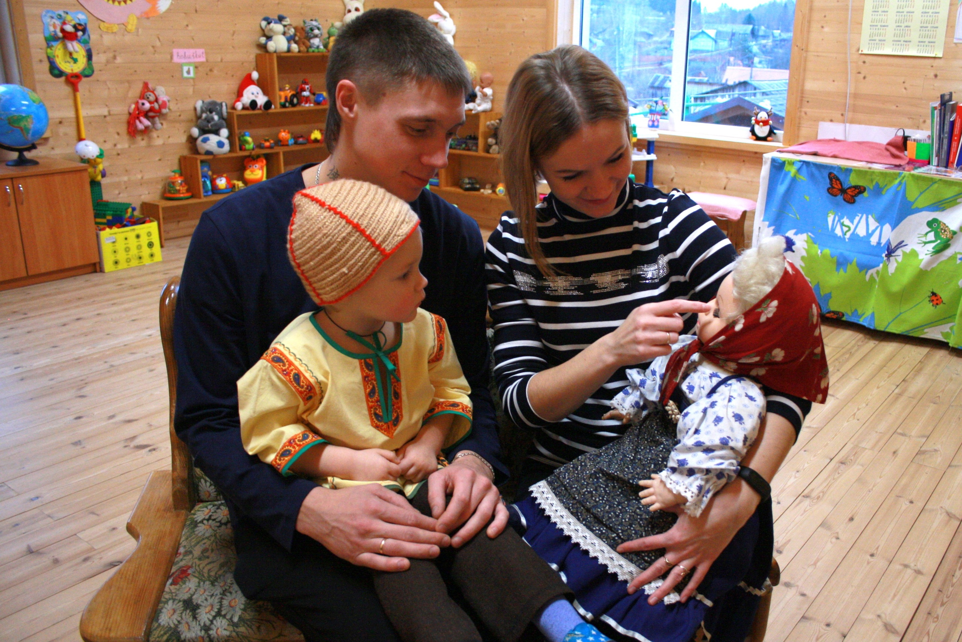
Russia - history and today
Even nomadic schools
Livvi-Karelian language nest
Instruction in Mordovian elementary schools
Evenk script
XVI Century Colonization of Siberia
1822 Statute on the Governing of Outsiders
Self-Determination under Soviet government 1920s
Russification after WW II
Ethnic renaissance 1980-90s
New Constitution 1993
Amendments to the Federal Law on Education 2017

Slide 15
Human Rights Lessons For the Decade (internal)
Assert indigenous peoples’ own visions of language rights
History – How did we get here?
Present -- Status of the language and its instruction?
Regional differences; urban-rural divide?
Future -- Fluency? Other goals?
Media, politics, science etc.?
Research, technological and scientific advancement that benefits IPs?
Language appropriation versus access?
Youth participation, pride, culture?
Rights & responsibilities: It’s up to us! Speak indigenous languages!! Develop infrastructure & commitment

Slide 16
Human Rights Lessons For the Decade (external)
Emphasize standard setting language of the instruments (e.g., ICCPR, ILO 169, Declaration)
Identify specific challenges to human rights (e.g., policies sounding in national security or cultural unity → respond with plurilingual realities, intercultural peacemaking, individual and collective dignities, and right to life)
Develop a model of implementation including and transcending “enforcement”
National Action Plans
Participation of IPs & FPIC; dialogue & diplomacy
Holistic approach to rights
Remedial: State apology & funding at least commensurate with destruction efforts
Ongoing: Legislation (baseline standards) + mutual agreement (indigenous contexts)

Slide 17
In the spirit of our relatives
So that all may speak and live freely in the future

