Slide 1
Notes:
Introduction and acknowledgements
Thank you [chair] for your introduction.
Barayn Marrung
Miyanggan dhanang?
Dhanggu nyuwayi Craig Ritchie, ngaya guri Dhanggati.
Dhanggati guthun barri Gimbisiya watayiya, banduunggakayi yalanggurrgu;
Ngaya manhatinan guthunda barriya; ngaya baluwa, garrkung ngarran, nganhikurr nyinan barriya dhithiyndha ngun.ngun, barayn, ngundakang.
Good morning
How are you all?
My name is Craig Ritchie, I am a Dunghutti and
Dunghutti country is near Kempsey from the mountains to the sea.
I acknowledge the Indigenous people of this country, and pay my respect to elders past, present and future.
I would also like to acknowledge all Indigenous people here with us today.

Slide 2
Notes:
AIATSIS is Australia’s only national organisation to focus solely on the diverse cultures, traditions, languages and stories of Aboriginal people and Torres Strait Islanders.
Our vision is for a world in which Aboriginal and Torres Strait Islander knowledge and cultures are recognised, respected, celebrated and valued

Slide 3
Notes:
We work to achieve this vision though a simple but profound mission:
To tell the story of Aboriginal and Torres Strait Islander Australia
To create opportunities for people to encounter, engage and be transformed by those stories
To facilitate and support Aboriginal and Torres Strait Islander cultural resurgence; and
To shape the national narrative – the story we tell ourselves about ourselves

Slide 4
Notes:
Australia’s Indigenous peoples, consisting of Aboriginal peoples and Torres Strait Islander peoples, are highly diverse. Our cultures remain strong and we have many stories to tell. Our knowledge of the land, our ways of doing business, our science and innovation are all embedded in over 60,000 years of history.

Slide 5
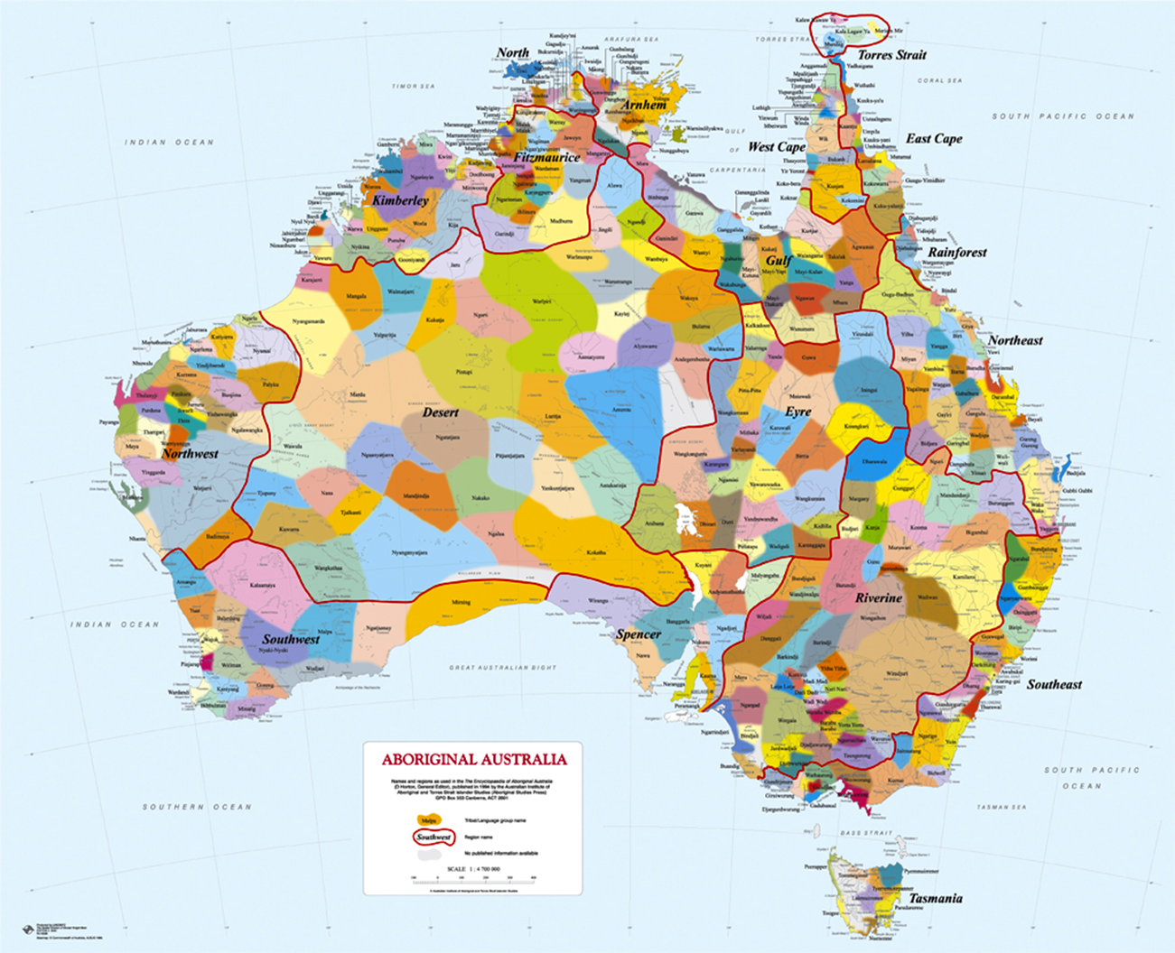
Indigenous Australia
Notes:
This map conveys effectively the great linguistic and cultural diversity within Indigenous Australia. Over 250 separate language groups were in existence at the time of settlement. Traditionally its AIATSIS’ best-selling publication has been the Aboriginal Australia wall map, which derives from research undertaken in the publication of the Encyclopaedia of Aboriginal Australia. Over its life it has sold more than 60,000 copies.
Change Slide

Slide 6
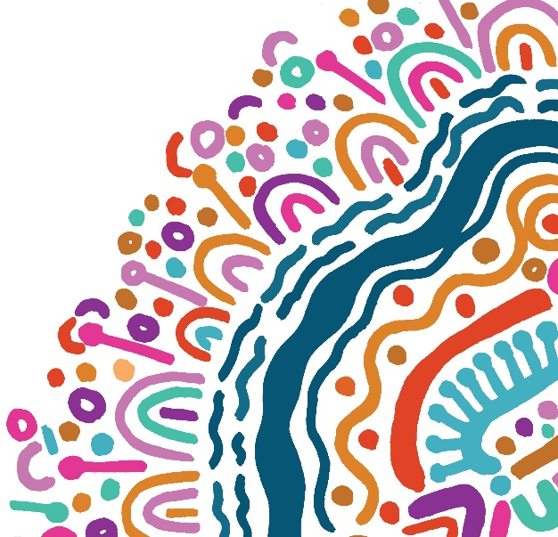
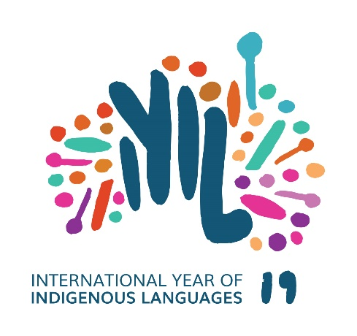
Australia’s Indigenous Languages

Slide 7
Strategic Objectives
Getting the narrative right:
Indigenous languages are AUSTRALIAN languages
Three overarching objectives
1. Every Australian language is documented
2. Every language community has the capability to strengthen their language
3. Every Australian has the opportunity to learn and take pride in an Australian language

Slide 8
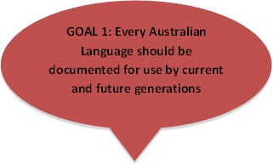
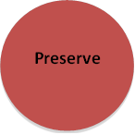
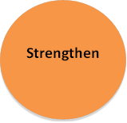
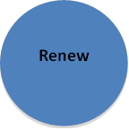
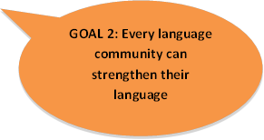
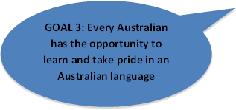
Framework for AIATSIS Language Strategy
AIATSIS Languages Collection Development
Corpora project
Living Language projects (eg. rangers)
AIATSIS Languages Collection Metadata
Dictionaries project
Singing the Train
AUSTLANG
Ngunawal Language Revitalisation project
Curriculum development workshop
Breath of Life program
National Indigenous Languages Survey 3

Slide 9
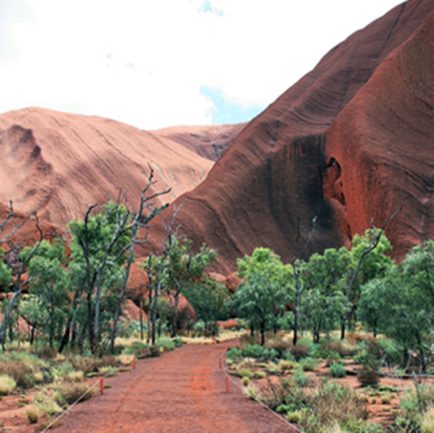
Languages in Australia
At the time of European colonisation of Australia an estimated 250 Aboriginal and Torres Strait Islander languages were present.
Today, 120 languages are still spoken.
13 languages are considered to be spoken ‘strongly’.
All languages, even strong ones, are under threat.
Some languages are reawakening
Notes:
At the time of European colonisation of Australia an estimated 250 Aboriginal and Torres Strait Islander languages were present.
Today, 120 languages are still spoken.
13 languages are considered to be spoken ‘strongly’ (by this we mean that most children learn and speak their language)
About 100 languages have speakers but are not being acquired by children,
of the 130 with no speakers, around 30 are being revived, or as we like to say ‘reawakening’
All languages, even strong ones, are under threat.
The impact of colonisation on Australian Indigenous languages has been uneven. Dharawal, for example, the language of the south coast of Sydney and below, had 50 speakers in 2014, but they could only speak a few words or sentences. By contrast, Warlpiri, a language of central Australia, has over 1000 speakers, many of whom have full fluency and use the language at all times. NILS2, 12, 15.
‘strong’ language is one where most children in the community are learning it as a matter of course

Slide 10
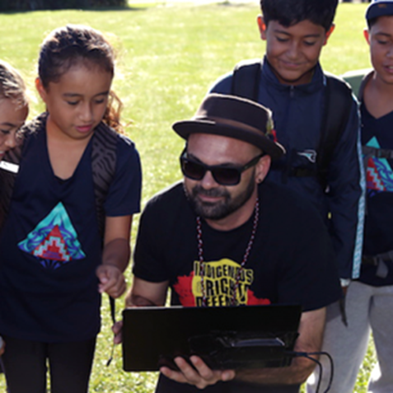
Language Ecology is Diverse
Indigenous language ecology in Australia is complex.
Some languages are no longer spoken.
Some languages are spoken at ceremonial events.
Some languages are spoken often as a language of communication within communities.
Some communities want their languages taught to non-Indigenous Australians, whilst others may not.
The strength of languages is often related to geography and history.
Languages that are sleeping are usually from areas where colonisation first occurred.
Notes:
Indigenous language ecology in Australia is complex.
Some languages are no longer spoken.
Some languages are spoken at ceremonial events.
Some languages are spoken often as a language of communication within communities.
Some communities want their languages taught to non-Indigenous Australians, whilst others may not.
The strength of languages is often related to geography and history.
Languages that are sleeping are usually from areas where colonisation first occurred.

Slide 11
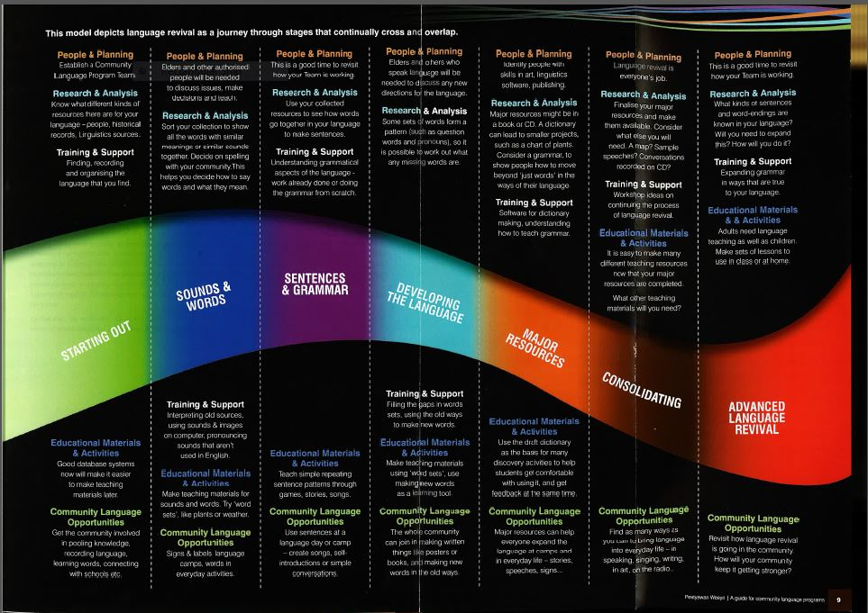
The language revival journey
Notes:
While there are around 130 languages with no speakers, close to 30 of these are being revitalised by their communities, drawing on historical materials (many of which are accessed at AIATSIS). While this is a long and difficult process, there have been some notable successes, eg Kaurna (language of Adelaide) where Kaurna people have worked for decades (with linguist support) to re-learn their language, and there are now children being brought up bilingual in Kaurna and English.
The language revival journey (see slide image) begins with the community, who have to be ready to embark on this activity, with an understanding of the difficulty and time it takes, and also the revisiting of the trauma of cultural loss.
The journey moves on to analysing historical materials to understand (initially) the sound system of the language and work with the community to develop a suitable writing system. From there it moves on to analysis of the grammar and the development of language learning materials for use by the community. Eventually there will be a need to develop a wide variety of materials, and also to develop the language with new words and expressions for (eg) ‘computer’.
Change Slide

Slide 12
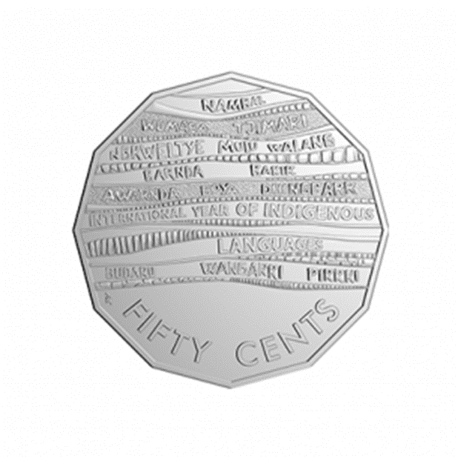
AIATSIS International Year Activities
The National Indigenous Languages Report (NILR)
Paper and Talk Language Revitalisation Workshop
AIATSIS Indigenous Languages Preservation: Dictionaries Project
Commemorative Coin and Stamp
AUSTLANG; Library of Congress adopting AIATSIS’ AUSTLANG codes
AIATSIS foyer space transformed by Community in the exhibition Ngalipa Nyangu Jaru: Pirrjirdi Ka Ngalpa Mardani (Our Language: Keeping Us Strong).
Notes:
Coin:
The Royal Australian Mint has produced a unique 50 cent coin to commemorate the 2019 International Year of Indigenous Languages. The coin incorporates words for ‘money’ in 14 different Indigenous languages, and symbolically leaves a blank space to represent sleeping languages. The coin has been released for general circulation.
Stamp:
Australia Post has released Australia Post marked International Year of Indigenous Languages 2019 with a commemorative stamp celebrating the more than 250 Indigenous languages in our nation’s history.
The map featured on the sheetlet pack represents the regions associated with the hundreds of Indigenous language variations, both current and historical, recorded in AUSTLANG, the Australian Indigenous languages database developed and maintained by AIATSIS.
AUSTLANG:
A database containing information from historical research on Aboriginal and Torres Strait Islander languages and dialects including the many spelling variations, the approximate location of the language and it’s speakers, as well as a link to our Mura catalogue records
Each language contains an alpha-numeric code – for example C15 is the code for Warlpiri, E6 is the code for Dhanggati.
The alpha-numeric code is a unique identifier and has been adopted by the United States Library of Congress as well as our own National Library of Australia’s Trove platform. This removes the generic name status of Aboriginal and Torres Strait Islander peoples
Foyer Space:
Representatives from Ngunnawal, Warlpiri and Meriam communities, and Wangka Maya Pilbara Aboriginal Language Centre gathered at AIATSIS on Friday 13 September, 2019, to launch the exhibition. Community members from each language group worked in partnership with AIATSIS to develop the exhibition as part of 2019 International Year of Indigenous Languages activities, promoting Indigenous languages throughout Australia.

Slide 13
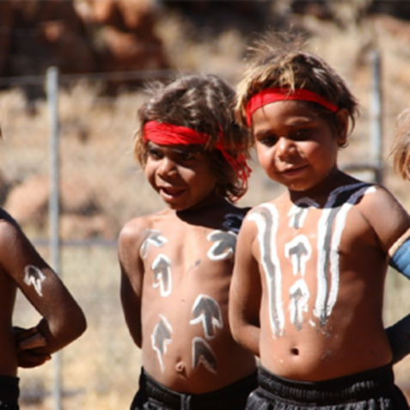
The Future of Languages in Australia
The National Indigenous Languages Report (NILR) 2019 will establish baseline data on Aboriginal and Torres Strait Islander languages.
The NILR will demonstrate the benefits of language for improving social and economic outcomes.
The NILR will provide an important evidence-base for future languages policy.
Notes:
This year, AIATSIS will release its third in a series of National Indigenous Languages Surveys, which builds off two previous studies in 2005 and 2014.
The National Indigenous Languages Report (NILR) 2020 establishes baseline data on the current state of Aboriginal and Torres Strait Islander languages.
It is the source of the figures on language endangerment I have spoken about today.
The NILR will demonstrate the benefits of language for improving social and economic outcomes.
The NILR, alongside extensive community consultations, will provide an important evidence-base for future languages policy.

Slide 14
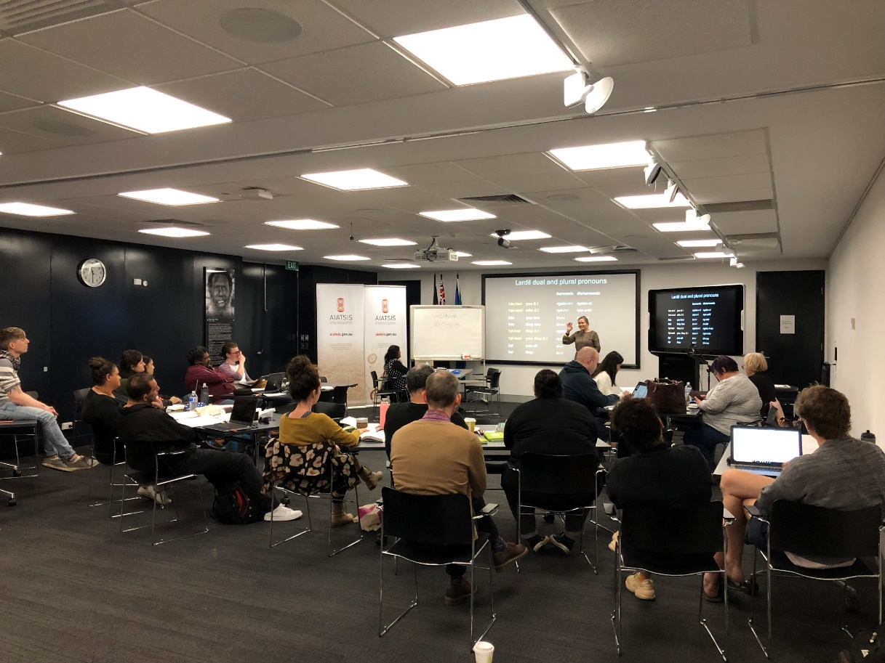
Paper and Talk
Paper and Talk is a workshop designed to support Indigenous people in exploring archives so they can develop language resources to assist in strengthen and revitalise their languages.
Across the two week participants received training and learnt practical skills in linguistics.
Notes:
Paper and Talk is a workshop designed to support Indigenous people in exploring archives so they can develop language resources to assist in strengthen and revitalise their languages.
Inspired by the US Breath of Life Institute, our Paper and Talk workshop was the result of a collaboration between AIATSIS and Living Languages (formally RNLD).
Across the two week participants received training and learnt practical skills in linguistics. Training involved learning word types and basic morphology, sounds and writing training, and grammatical concepts and terminology.
The workshop took place 1-13 September 2019 in Canberra Australia.
3-4 community members were involved from the following language groups:
Ngunnawal (ACT)
Wakka Wakka (South-East QLD)
Anaiwan (New England Tablelands region in the northeast NSW)
Yorta Yorta (VIC)
Wergaia (VIC)

Slide 15
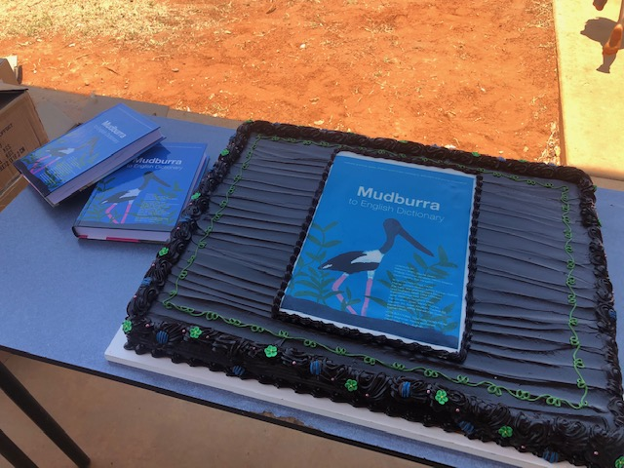
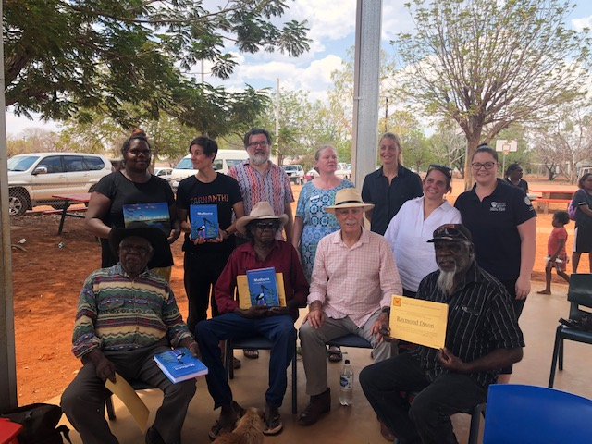
AIATSIS Indigenous Languages Preservation: Dictionaries Project
The project supports the publication of 21 Aboriginal language dictionaries
Over the course of the International Year of Indigenous Languages, 6 dictionaries were published.
Dictionaries play an important role in language preservation and revitalisation.
Notes:
The project supports the publication of 21 Aboriginal language dictionaries that are in an advanced stage of development - there are many cases where a good dictionary database has been created for a language, perhaps over decades of work, but a lack of funding has prevented publication from taking place
Over the course of the International Year of Indigenous Languages, 6 dictionaries were published.
Dictionaries play an important role in language preservation and revitalisation, both in schools and communities, and also as a way to share knowledge about languages with non-Indigenous Australians.

Slide 16
For further information please contact:
Craig Ritchie
CEO
languages@aiatsis.gov.au

