Slide 1
Sami Parliament and the Sami Language

Slide 2
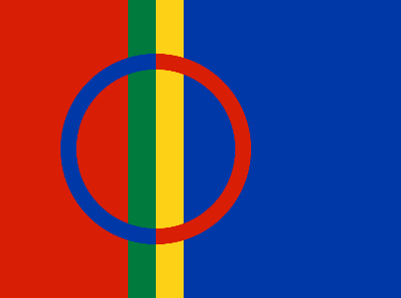
Samis and the Sami Languages
Sámediggi
Notes:
The Sámi are an indigenous people with traditional territories within the national borders of Finland, Norway, Sweden and Russia. The Sámi people have lived in their settlements long before the national borders were established.
The Sámi people are a group of indigenous peoples in Northern Europe. The Sámi people have their own history, culture, language and traditional territories known as Sápmi.
The Sami population is estimated to 80 000 – 100 000 or more. Most of the Sámis live in the norwegian part of Sápmi, there is the population estimated to approximately 60 000 samis.
The Sámi languages are defined as a branch of the Uralic language family, and are spoken in an area stretching from central Norway and Sweden, through northern Norway, Sweden and Finland, to the Kola Peninsula in Russia.
Today there are altogether 10 Sámi languages, which are more or less mutually unintelligible; especially languages that are geographically distant. The languages differ from one another at least to the same degree as i.e. Germanic languages. Neighboring dialects on each side of language boundaries are normally close to each other, and the languages/dialects form a chain in which speakers of adjacent dialects understand each other.
The state borders do not follow the traditional boundaries between the Sámi languages. The language and dialectal boundaries go from east to west, while the state borders cross the language borders and go from north to south. For example, North Sámi is spoken in Norway, Sweden and Finland.
The number of language users varies from one language to another. The largest language is Northern Sámi (est. 20.000–40.000 users). All Sámi languages are minority languages in the respective countries.

Slide 3
Sami livelihoods and Sami Languages
Sámediggi
Notes:
Sami livelihoods are important pillars for Sami languages, Sami culture and social life. In reindeer husbandry, fishing, agriculture and outlying livelihoods there is a living, diverse and rich language that has its own terminology. A large part of this terminology lives only in the livelihoods, and it is important that the living language of the livelihoods as well reaching out to the community.
Duodji, the traditional, Sami craft and handicraft, and traditional knowledge are also arenas where the language stands strong.
It is important that language carriers in Sami livelihoods and traditional knowledge are actively used for to carry on Sami languages ​​in both formal and informal arenas. Especially within Day Care institutions, elementary schools and within local language measures are the use of language carriers useful and of great value.

Slide 4
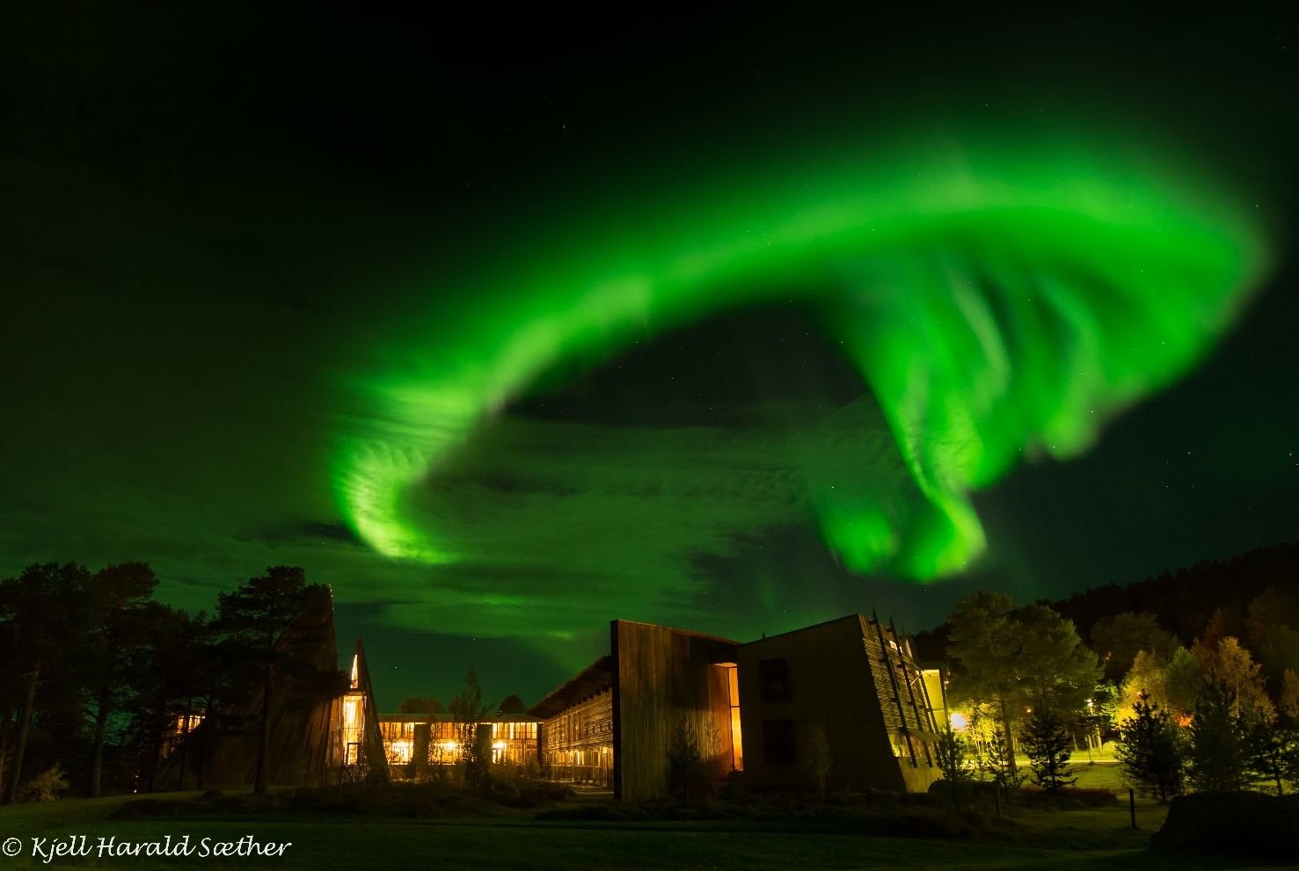
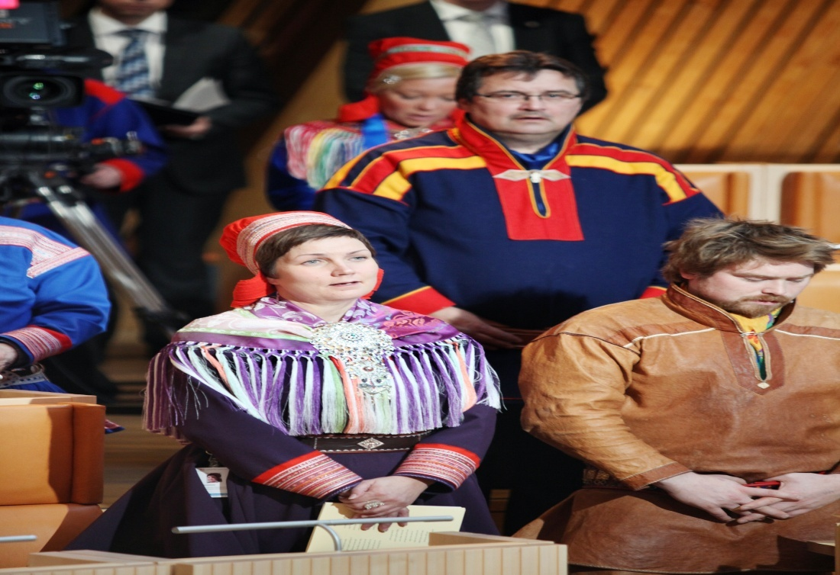
Sámediggi / The Sami Parliament
SÁMEDIGGI
Picture: Sami Parliament 2013-2017
The elected assebly for and by the Sámi people of Norway comprises 39 representatives from seven constituencies
Notes:
The Sami Parliament in Norway comprises 39 representatives from seven constituencies. (We will return to the allocation of the constituencies later, under “Sami Parliament in Norway elections”. ) (Constituency 1 Østre, Constituency 2 Ávjovárri, Constituency 3 Nordre, Constituency 4 Gáisi, Constituency 5 Vesthavet, Constituency 6 South Sami, Constituency 7 Southern Norway)

Slide 5
The role of Sámediggi
Sámediggi
The Sámediggi in Norway is the Sami’s elected governing body, elected by and among the Sami population
The Sámediggi in Norway plays an important role in helping the Norwegian government ensure that the Sami can safeguard and develop their language, culture and way of life
Notes:
The Sami Parliament in Norway (Sámediggi in Northern Sami; Sametinget in Norwegian) is a political instrument intended to reinforce the Sami’s political position and help secure fair treatment for the Sami people.
As an indigenous people, the Sami have a different standing to other ethnic minorities in the Nordic region. The Sami are not immigrants, having lived in their settled areas long before the borders were drawn for today’s nations. Consequently, the Storting (the Norwegian Parliament) has ruled that the Sami language and Sami culture must be viewed as indigenous to Norway, and enjoy the same requirements with regard to preservation and development opportunities as the languages and cultures of the majority Nordic populations.
One of the important motivations for the establishment of the Sami Parliament in Norway was that, as a minority, the Sami are precluded from representation on the standard bodies based on a mass-democratic system. The Sami Parliament in Norway was established in order to remedy this, and to provide the Sami with a common voice. This does not mean that all representatives in the Sami Parliament agree among themselves, but that adopted motions are based on a political process.

Slide 6
Why was Sámediggi established?
sámediggi
Historical
Political
Legal
Pratical

Slide 7
Áltá-Guovdageaidnu conflict
Sámediggi
Conflict started in 1970
Máze protected in 1973
Storting decide to build the dam in 1978
Demonstrations started in june 1979
Conflict ends in 1982
Notes:
The conflict over the damming of the Alta River began as early as the 1970s, when the development plans were submitted for the first time. The plan affected vital Sámi territory, and among other things involved the submergence of 200 people’s homes at Masi. In 1973, following a visit to Masi by a Storting committee that was greeted by massive protests, a resolution was passed granting permanent protection of Masi. In 1974 the district councils of Alta and Kautokeino voted to oppose the hydropower scheme; in the same year, however, Finnmark County Council recommended the dam. On 30 November 1978 the Storting passed a plan for the river with a dam at Sávžu.
The Storting’s decision led to extensive protests from the Sámi and from environmentalists. The Popular Movement against the Development of the Alta-Kautokeino River was created, and petitions with more than 15,000 signatures were presented to the Storting. In June 1979 the Popular Movement began to employ civil disobedience against construction work at Detsika, near Alta. In October of the same year a group of Sámi underwent a hunger-strike at Eidsvollsplass, the little square just outside the Storting. These demonstrations led to a suspension of the development work.
After Alta District Court gave judgement that construction had been lawfully begun, however, work resumed in January 1981, triggering a new campaign of civil disobedience. Protests were stopped by police action. A group of Sámi underwent a hunger-strike from 24 January to 25 February. Construction work was once again halted to determine whether the development was in conflict with the Cultural Monuments Act, but resumed in September 1981 without major interruption. In 1982 the Supreme Court ruled that the development was legal, and the Popular Movement was dissolved in that year. During certain phases of the conflict large numbers of police were stationed in Alta.

Slide 8
Why was the Sami Parliament in Norway established?
Sámediggi
The Sami are a minority, indigenous people in Norway
To safeguard the future of the Sami language and culture
To safeguard Sami interests and values
To safeguard Sami rights
Norway has obligations to its indigenous population under international law
The establishment of an elected body is an effective way of fulfilling such obligations
Notes:
The Sami are a minority, indigenous population
To safeguard the future of the Sami language and culture
To safeguard Sami interests and values
To safeguard Sami rights
Norway has obligations to its indigenous population under international law
The establishment of an elected body is an effective way of fulfilling such obligations
The need for knowledge of Sami language and culture
Policy-maker
To enable the Sami to develop their own society
Value basis
To preserve traditions
To ensure that nature is looked after in line with Sami values
To ensure that the language and culture are passed on to future generations

Slide 9
The authority of Sámediggi
Sámediggi
On matters where the central authorities have devolved such authority to the Sámediggi in Norway, including preservation of Sami cultural heritage, education, language, commerce, and culture
Allocates own budget
Mandatory public enquiry body for matters concerning the Sami population
The Sámediggi in Norway may review each matter in the manner it deems necessary

Slide 10
Legislation

Slide 11
The Norwegian Constitution
Sámediggi
§ 108 of the Norwegian Constitution states that: It is the obligation of the State authorities to create the conditions necessary for the Sami their to protect and develop language, their culture and their society.
The purpose of the Sami Act § 1-1: The purpose of the Act is to enable the Sami people in Norway to safeguard and develop their language, culture and way of life.
ILO 169
The Education Act
The Reindeer Husbandry Act
The Finnmark Act
Notes:
The Sámi have been recognized as an indigenous people in Norway (1990 according to ILO convention 169), and therefore, according to international law, the Sami people in Norway are entitled special protection and rights.
The constitutional amendment states: "It is the responsibility of the authorities of the State to create conditions enabling the Sámi people to preserve and develop its language, culture and way of life." This provides a legal and political protection of the Sámi language, culture and society. In addition the "amendment implies a legal, political and moral obligation for Norwegian authorities to create an environment conducive to the Sámis themselves influencing on the development of the Sámi community".
The Sámi Act provides special rights for the Sámi people:
"... the Sámis shall have their own national Sami Parliament elected by and amongst the Sámis" (Chapter 1–2).
The Sámi people shall decide the area of activity of the Norwegian Sámi Parliament.
The Sámi and Norwegian languages have equal standing in Norway (section 15; Chapter 3 contains details with regards to the use of the Sámi language).
In addition, the Sámi have special rights to reindeer husbandry.
The Norwegian Sámi Parliament also elects 50% of the members to the board of the Finnmark Estate, which controls 95% of the land in the county of Finnmark.

Slide 12
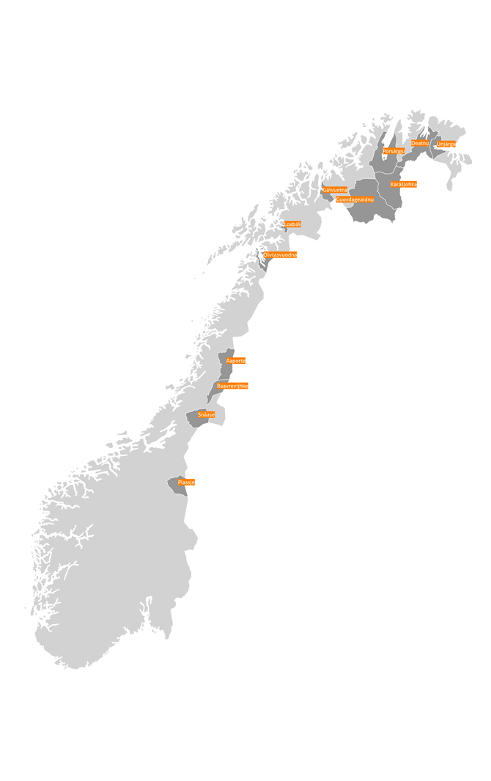
Right to use the Sami language in accordance with Chapter 3 of the Sami Act
Sámediggi
Notes:
The municipalities marked in the map are in the Sami district according to the law. In these municipalities, the legislation in Chapter 3 of the Sami Act applies.
Today we have 13 municipalities in the Sami district (and the three northernmost counties).
Chapter 3 of the Sami Act contains provisions on translation of rules, announcements and forms to Sami, right to a reply in Sami, extended right to use Sami in the judicial system and in the health and social sector, individual church services, right to leave of absence for educational purposes, right to tuition in Sami and provisions that it is possible to equate Sami language with Norwegian in the municipal administration.
Several municipalities have problems meeting the requirements of the Sami Act. The Sami Parliament and the ministries are now revising the Sami Act

Slide 13
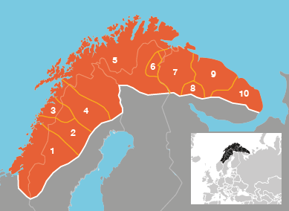
Sami children's rights to daycare and education
Sámediggi
Notes:
The Sami district is very central in relation to the rights of the Sami.
Examples:
Act on Day Care Institutions states:
The municipality is responsible for ensuring that kindergartens for Sami children in Sami districts are based on the Sami language and culture. In other municipalities steps shall be taken to enable Sami children to secure and develop their language and their culture.
The Education Act states:
In Sami districts all children at the primary and lower secondary level have the right to receive education both in Sami and through the medium of Sami.
Outside Sami districts, if at least ten pupils in a municipality wish to receive instruction in and through the medium of Sami, they have the right to such education as long as there remain at least six pupils in the group.
There is a big difference between the rights within and outside the administrative area.
I have also inserted the map showing the entire Sami area. Here you see that several of the rights apply only within a small geographical area.

Slide 14
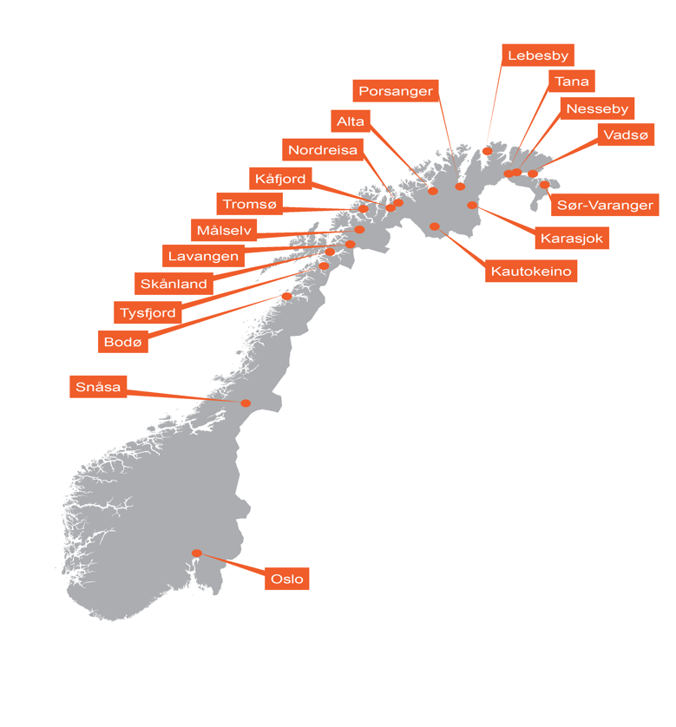
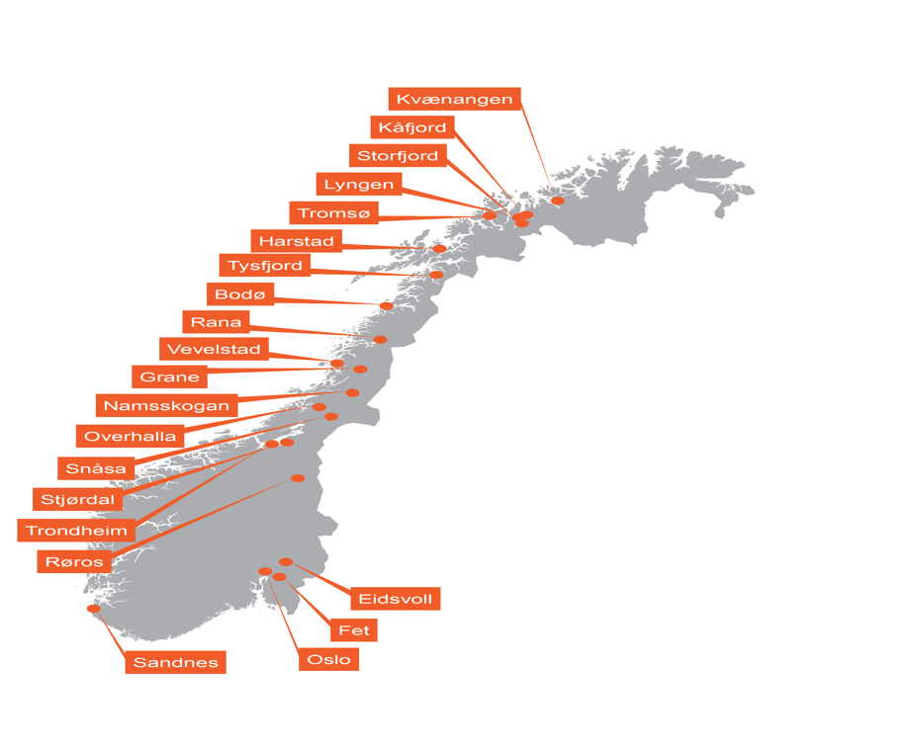
Sami Day Care institutions and Day Care institutions with Sami facilities
Sámediggi
Notes:
The map on the left is an overview of Sami Day Care institutions and Day Care institutions with Sami section. The map on the right is an overview of Day Care institutions that offer language services to an individual child or to a smaller group.
We know that there are Sami children living all over Norway, so we expected the maps to be completely filled.
One problem with several of the laws is the compliance. Although children have the right to Sami both at school and at Day Care institutions, it is often the case that the guardians must demand this right for their children. ..and many guardians do not know about children's rights to Sami

Slide 15
Establishment of Sami rights
Sámediggi
1987 – The Sami Act
1988 – The Norwegian Constitution, §108 (earlier §110a)
1989 – Opening of the Sámediggi in Norway
1990 – ILO Convention no. 169
1992 – Language rules (the Sami Act)
1998 – Sami education (the Education Act)
2005 – The Finnmark Act
Notes:
These laws guarantee the Sami people the right to develop their language, culture and way of life. One problem with several of the laws is the compliance. For example, Sami children have the right to education in Sami in kindergarten and school. But often it is the guardians who have to demand this right for the children, so that they get the education they are entitled to.

Slide 16
International Law
Sámediggi
UN Convention on Civil and Political Rights (1966)
UN Convention on Economic, Social and Cultural Rights (1966)
UN Convention on the Rights of the Child (1989)
UN Convention on the Elimination of All Forms of Racial Discrimination (1965)
UN Declaration on the Rights of Indigenous Peoples (2007)
ILO Convention no. 169 on Indigenous and Tribal Peoples (1989)
Convention on Biological Diversity (1992)

Slide 17
Consultations with government authorities
sámediggi
The consultations are intended to secure:
practical implementation of the ILO convention – the obligation to consult has existed as such since the ILO convention was ratified
the reaching of agreement
the development of a partnership perspective
a common understanding of the needs of Sami communities

Slide 18
Consultations with government authorities
sámediggi
The Sami Parliament in Norway shall have the opportunity to exercise real influence on processes and results
Consultations are more than just a public enquiry – it is a requirement that agreement be sought, and where agreement is not reached that such shall be justified
The rules of procedure were established by Royal Decree on 1 July 2005

Slide 19
Political organisation

Slide 20
Plenary leadership
sámediggi
Tom sottinen, Plenary Chair
Task
The plenary leadership prepares agenda lists, convenes and chairs the Sami Parliament in Norway’s plenary sessions
Rules on leave applications and presents recommendations to the plenary session on matters regarding the Sami Parliament in Norway’s order of business
Appoints participants and representatives for Parliamentary meetings and conferences

Slide 21
Executive Council of Sámediggi in Norway
sámediggi
Functions as the Sámediggi`s “government”
Responsible for daily political business
The Executive Council bases its business on the minority vote of the plenary session
This term comprises President Aili Keskitalo, members of the council Henrik Olsen, Hans Ole Eira, Silje K. Muotka, Mikkel Eskil Mikkelsen
Full-time members of the Sámediggi in Norway

Slide 22
The Planning and Finance Committee
sámediggi
Deals with budgetary matters, annual reports, Sami Parliament in Norway and other plans, guidelines for support schemes, equality issues, Sami rights, rights under international law, international issues.

Slide 23
The Welfare and Education Committee
sámediggi
Deals with nursery schools, daycare facilities for school children, primary, lower secondary and upper secondary education, higher education and research, and conditions for growing up for children and young people in general, family policy and social conditions and health

Slide 24
The Business and Culture Committee
sámediggi
Deals with commercial activities such as travel and tourism, reindeer husbandry, agriculture, fishing, catch quotas, combination industries, aquaculture and salmon fishing, and oil and energy, transport and infrastructure, culture, churches, cultural monument and environmental protection, district construction and regional planning and collaboration agreements with county authorities

Slide 25
Audit Committee
Performs audits of all Sámediggi`s business
Ensures that business is conducted in line with adopted guidelines and budgets
Presents matters to the plenary session within its area of expertise

Slide 26
Sami collaboration
Joint meeting between the Sami Ministers and the Presidents of the Sámediggis in Norway, Sweden and Finland
Sami Parliamentary Council
Joint Sami Language Council
President meetings

Slide 27
Sami institutions

Slide 28
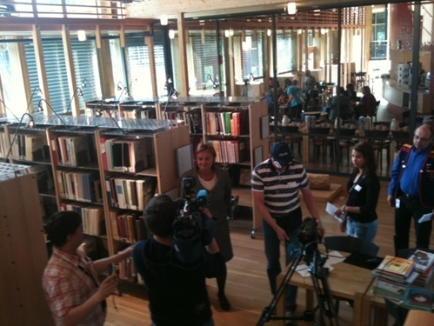
Sami institutions
Sámediggi
Notes:
Sami institutions are businesses that spring from and function in one Sami community context and Sami public. All societies are largely made up of one seen with different institutions, with the variations it entails. Institutions are therefore crucial pieces to achieve strong, functioning and developing societies. This is also the case for the Sami society. The development and development of the Sami community requires the will and ability to establish and further develop their own institutions. Sami institutions, organizations and actors play an important social role, and is helping to shape the Sami community. It will be important that these institutions, organizations and stakeholders actively participate in efforts to strengthen and develop Sami languages ​​locally, regionally and nationally.

Slide 29
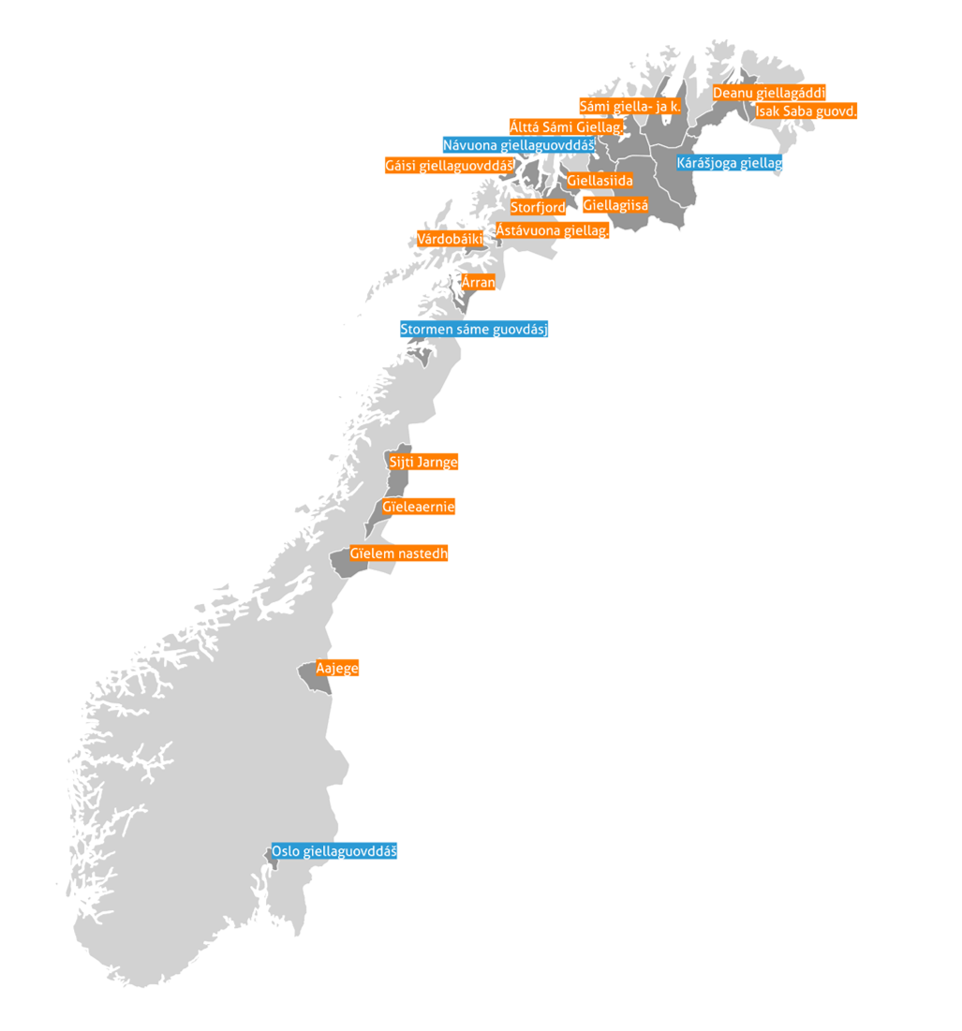
Sami language centers
Sámediggi
Notes:
Today we have 14 Sami language centers in Norway.
The Sami language centers are important players in the effort to strengthen and develop Sami language locally. The work of the language centers contributes to make the Sami language more visible, and is contributes to creating gathering points and arenas for the use of Sami languages. Sami language centers, as well as kindergartens and elementary schools, have a central role in language education locally. The language centers hold importance professional expertise and constitutes the core of Sami language learning outside of elementary school. Several language centers benefit from local language carriers and transfer of traditional knowledge is an important part of language centers offer.

Slide 30
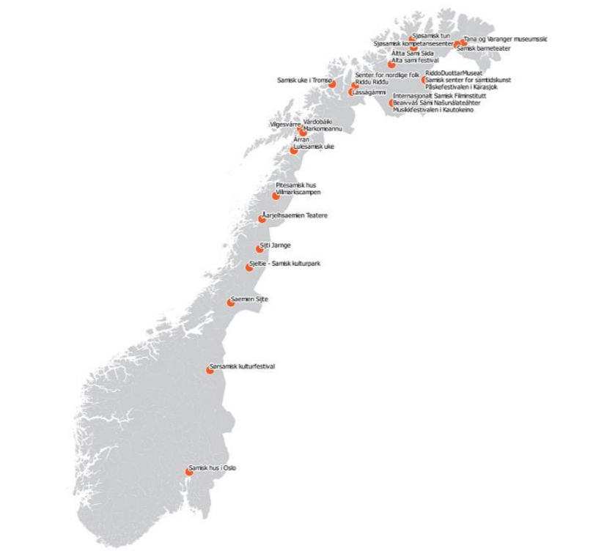
Sami cultural institutions
Sámediggi
Notes:
In Sápmi we have several Sami cultural institutions. Only Sami cultural institutions that receive funding from the Sami Parliament are marked on the map.
The Sami media institutions are not marked in the map. We have several Sami newspapers and Norway's national broadcasting also has its own Sami department with TV and radio in Sami language.
The various Sami cultural institutions have an important value, role and function in the Sami community community building and democracy development. They are also important as an infrastructure for democracy and freedom of expression and as a basis for community formation.
The Sami institutions can be divided into several categories; Stage, visual art, film, literature, joik / music and festivals, museum and cultural centers / cultural houses / meeting places. An important part of this work is also the Bååstede project, which is the return of Sami heritage. Work has begun on bringing back the Sami cultural heritage that was taken away from the Sami community. By returning our Sami heritage to Sápmi, we have the opportunity to tell our own story.

Slide 31
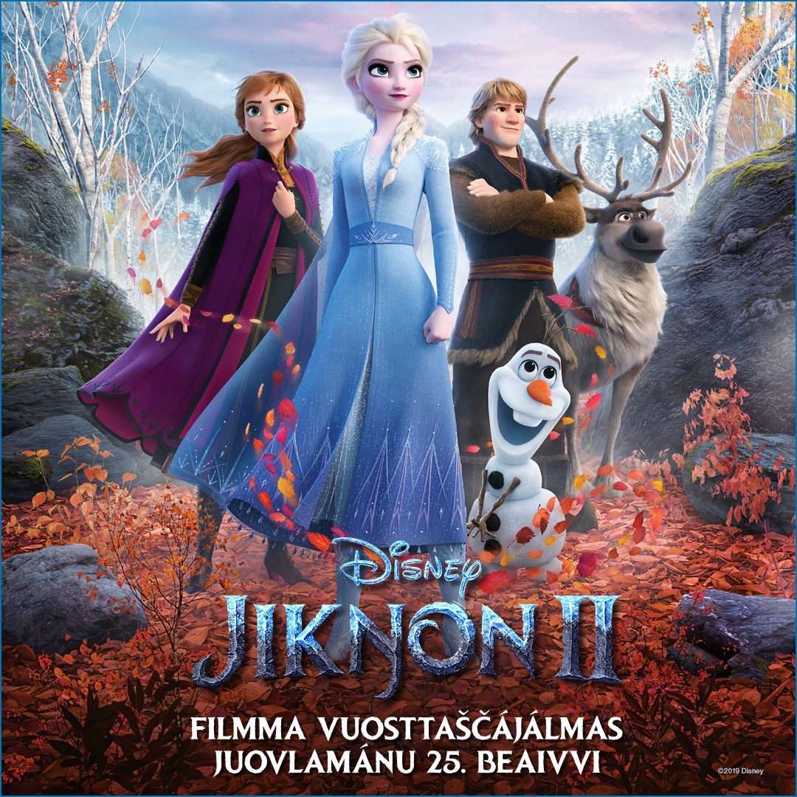
Frozen II / Jikŋon II
Sámediggi
Notes:
This is the first time Disney dubbed one of their films into a Sami language. This is the result of a collaboration between the Sami Parliament on the Norwegian, Swedish and Finnish sides, the joint Sami organization Saami Council – and one of the world’s largest media and entertainment companies: Walt Disney Animation Studios.
Films for children and young people are important language providers, and films with Sami language choices and films with Sami text choices are important for children's language development. Recently, we have also received several films in Sami. The International Sami Film Center has also dubbed the children's film "Chihiro and the Witches" into one of the Sami languages.

Slide 32
Elections

Slide 33
Sami Parliament in Norway elections
Sámediggi in Norway elections are held every four years, at the same time as elections to the Stortinget
The Sámdiggi in Norway is the highest election authority for the Sámediggi in Norway elections
Any person registered in the Sámediggi in Norway’s electoral register may vote and stand for election
Anyone who is also entitled to vote in the Stortinget election may vote in both elections
The Sámediggi in Norway’s electoral system was significantly amended in 2009

Slide 34
The Sami Parliament in Norway’s electoral register
To be included in the electoral register, potential voters must:
consider themselves to be Sami, and
have Sami as their domestic language, or have or have had a parent, grandparent or great-grandparent with Sami as his or her domestic language, or
be the child of a person who is or has been registered in the electoral register

Slide 35
Changes in the electoral register Pr. 1.10.2017 electoral register 17079 persons

Slide 36
Constituencies from 2009 and today
Seven constituencies covering the whole of Norway
Each constituency is assigned mandates in accordance with the number of people registered in the area’s electoral register
A total of 39 representatives are elected from the whole of Norway

Slide 37
Administration

Slide 38
Administration

Slide 39
Location of administrative offices
Ájluokta-Drag
Evenašši-Evenes
Kárášjohka-Karasjok
Guovdageaidnu-Kautokeino
Gáivuotna-Kåfjord
Snåase-Snåsa
Vuonnabahta-Varangerbotn
Romsa-Tromsø

Slide 40
Sami Parliaments work on language issues during 2019

Slide 41
Sámi Giellagáldu
Notes:
One of the goals of the Sami Parliament for the International Year of Indigenous Languages ​​was to strengthen cross-border language cooperation, by ensuring the sustainable operation of Sámi Giellagáldu. During the indigenous language year, the Sami Parliament worked together with the Sami Parliament on the Finnish and Swedish sides to find an organizational model for Sámi Giellagáldu.
As I mentioned in the beginning, the Sami languages ​​extend across national borders. The Sami languages ​​are influenced by the majority languages ​​in the countries and develop in different directions. Therefore, it is important that we have a cross-border cooperation to preserve the languages.
The Sámi Parliament raised a case in cooperation with the Sámi Parliament on the Finnish and Swedish side regarding the organization of plenary sessions in Sami Parliamentary Council. Sami Parliamentary Council endorsed the model where the Sami Parliament on the Norwegian side serves as host, can best ensure efficient operation, and therefore chose this model as a future organizing model.
The goal is for Sámi Giellagáldu to be in permanent operation during 2020.

Slide 42
Sami language technology
Notes:
In the efforts to preserve and revitalize the Sami languages, language technology will play an important role. In Sápmi, we are fortunate to have several language technology tools available. Divvun and Giellatekno at the Arctic University of Norway, the University of Tromsø have been very helpful in getting the Sami languages ​​into the technological world. Today, there are many technological tools that can help us write and communicate in several of the Sami languages. We are fortunate to have so many technological tools available in Sami languages
Technology is constantly evolving, at a speed that makes it difficult to keep track of everything that happens. This is especially true for smaller languages, and all Sami languages ​​are smaller languages ​​when viewed in a world context. Working with the big technology companies is important, as they have the opportunity to make a difference and to help. These companies work daily to improve their products so that users have the best possible experience, that users have simple solutions, and make users happy.
It is time for language technology tools and products to be open source, so that indigenous and other minority languages ​​can also be integrated into these tools and products. Statistically, most of the indigenous languages ​​are either endangered, seriously threatened or extinct. Unless we together can find a solution and help each other, then this trend will continue. We know that a language is not just a language, but a society of knowledge, philosophy and philosophy of life, and therefore it is important that Sami languages, and also other indigenous languages, be given the opportunity to become part of the great technological and digital world that we are a part of today.

Slide 43
Váibmogiella - Norway's public inquiry
Notes:
In 2016, Norway's public inquiry, Váibmogiella, came up with proposals for legislation, measures and regulations for Sami languages.
The purpose of the report has been to assess and propose measures to ensure functional and equal public services in Sami.
The task of the committee was to explain the current schemes, measures and regulations related to the Sami languages, and to assess how these can be adapted to the current organization of the public sector and ensure functional and equal public services in Sami.
The Sámi Parliament is still consulting on the proposals in the document.

Slide 44
Giellalokten
Notes:
Since 2019 was the International Year of Indigenous Languages, it was no coincidence that in December 2018, the Sami Parliament adopted the Sami Parliament's strategies for Sami languages ​​- the Giellalokten (Language lift). Giellalokten is the Sámi Parliament's overall focus on Sami languages ​​and consists of a number of measures, both taken from the previously shown Norway's public inquiry Váibmogiella, but also a number of other measures that are naturally associated with proposals for measures that are proposed in the Norway's public inquiry, Váibmogiella.
The Sami Parliaments vision for Sami languages ​​is that Sami languages ​​are natural, social and living languages. Sami languages ​​should be a natural part of society and everyone should be given the opportunity to hear, see and use Sami languages ​​in all areas of society. To achieve such a goal, a long-term commitment to Sami languages ​​is needed, and the language gap is thought to have been implemented over several years. The strategies are comprehensive, and show the Sami Parliament's comprehensive and sectoral language policy for the coming years. Giellalokten contains a number of concrete measures in different areas of society, and also at different levels within the different areas of society.

Slide 45
Sami Parliaments work on language issues during 2019
Notes:
The Sámi Parliament's official marking of the start the International Year of Indigenous Languages ​​and Giellalokten was a Sami language conference in Tromsø in February 2019. The conference gathered around 400 participants from different parts of Sápmi, and also with participants from Greenland. The conference was interpreted in Southern, Lule and Northern Sami, and all Sami languages in Norway ​​were used from the podium. The conference was streamed and achieved viewer records of the Sami Parliament's streaming offer.
Sami language week.
During 2019, the Sami Parliament has followed up on a number of measures in Giellalokten. Sami language week was an important and successful measure, and a number of actors helped to make Sami languages visible in the community during Sami language week.

