Slide 1
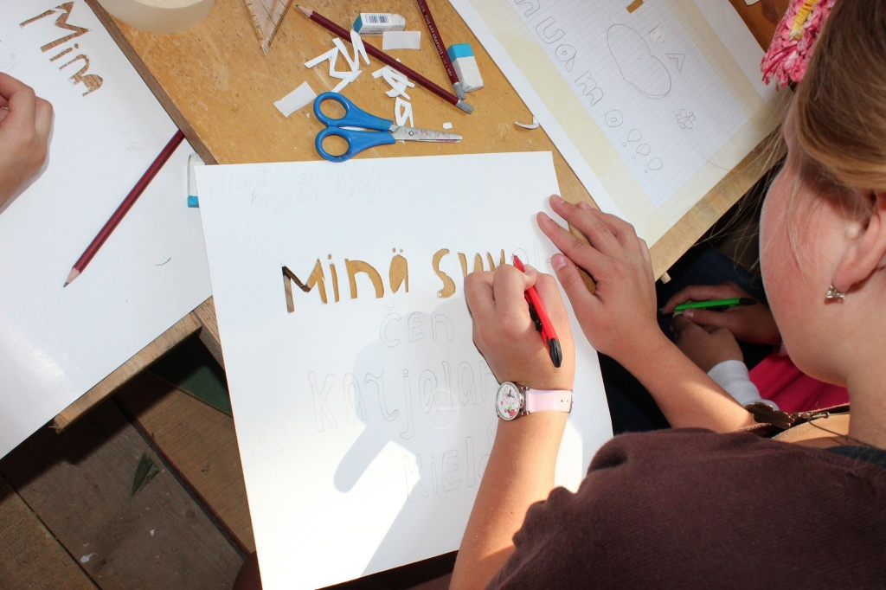
Public Activism for Multilingualism
Aleksei Tsykarev
Chair of Center for Support of Indigenous Peoples and Civic Diplomacy “Young Karelia”
http://www.nuorikarjala.ru

Slide 2
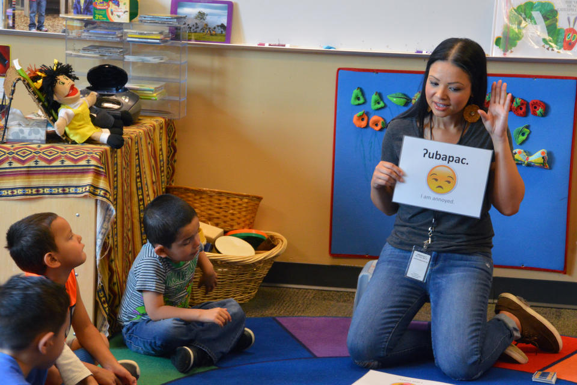
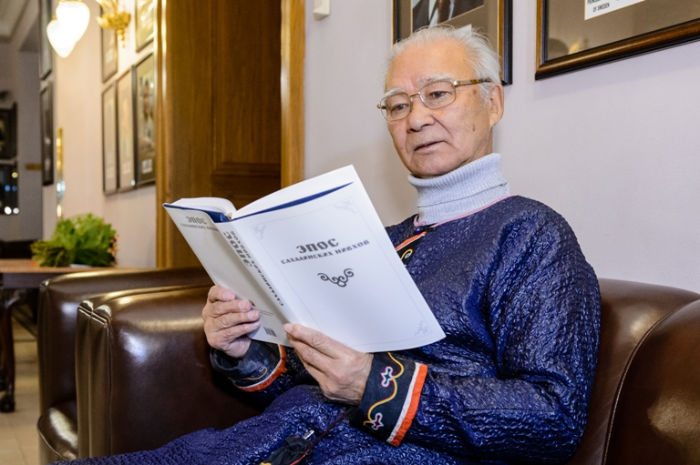
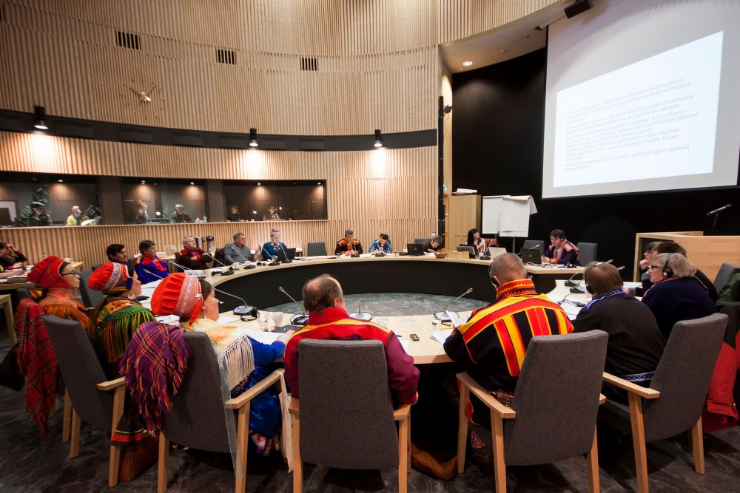
Language vitality: Media, Education, Administration and Cyberspace

Slide 3
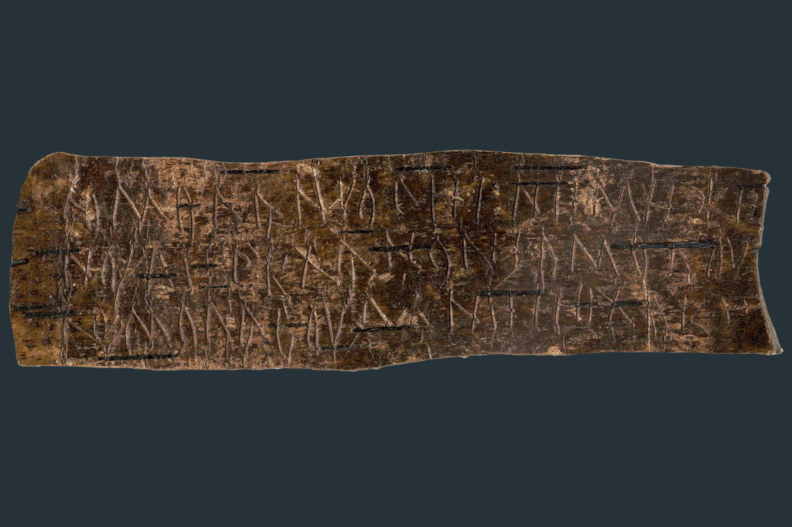
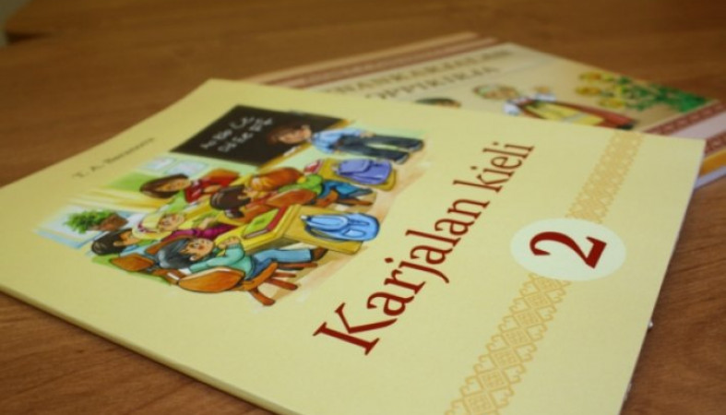
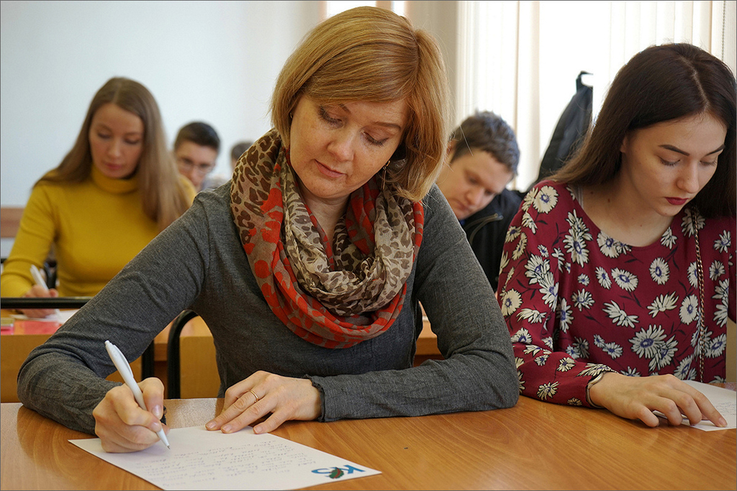
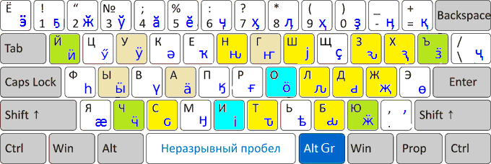
Linguistic communities to control education and writing systems

Slide 4
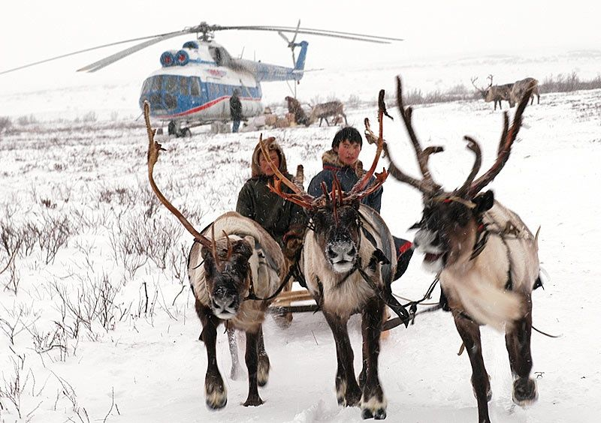
Indigenous languages matter for development and modern democracy

Slide 5
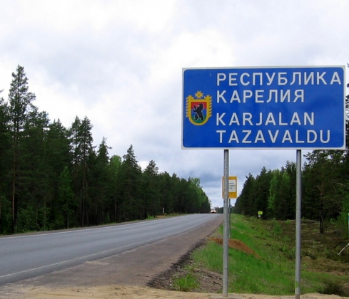
Year of the Karelian Language 2013

Slide 6
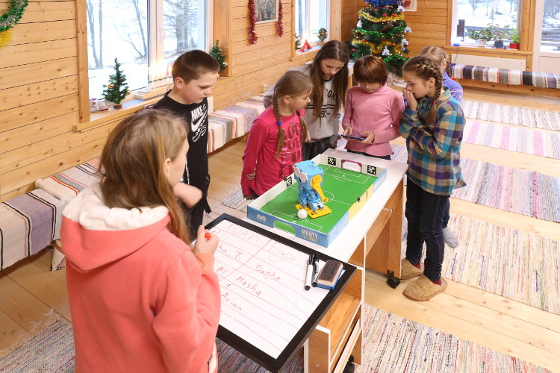
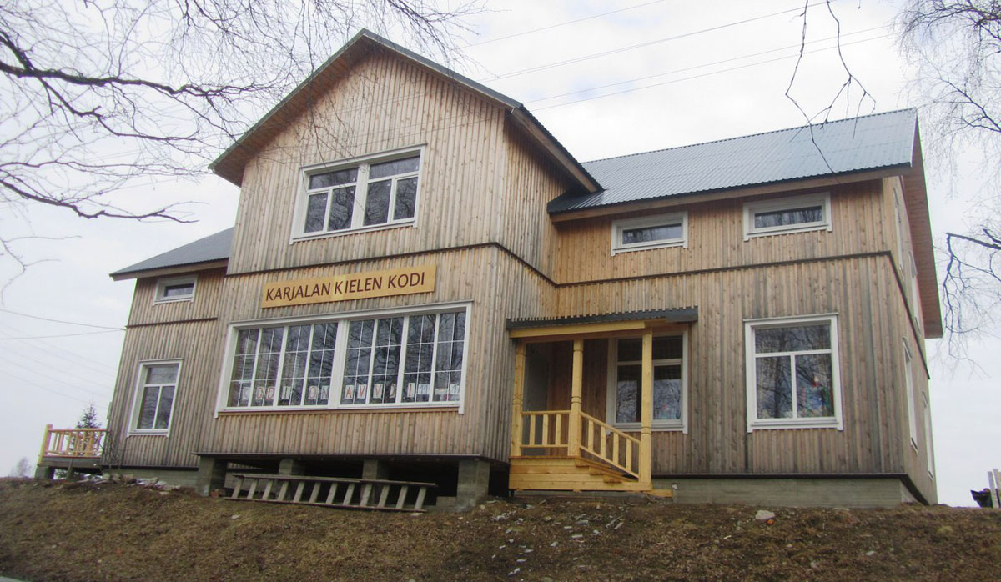
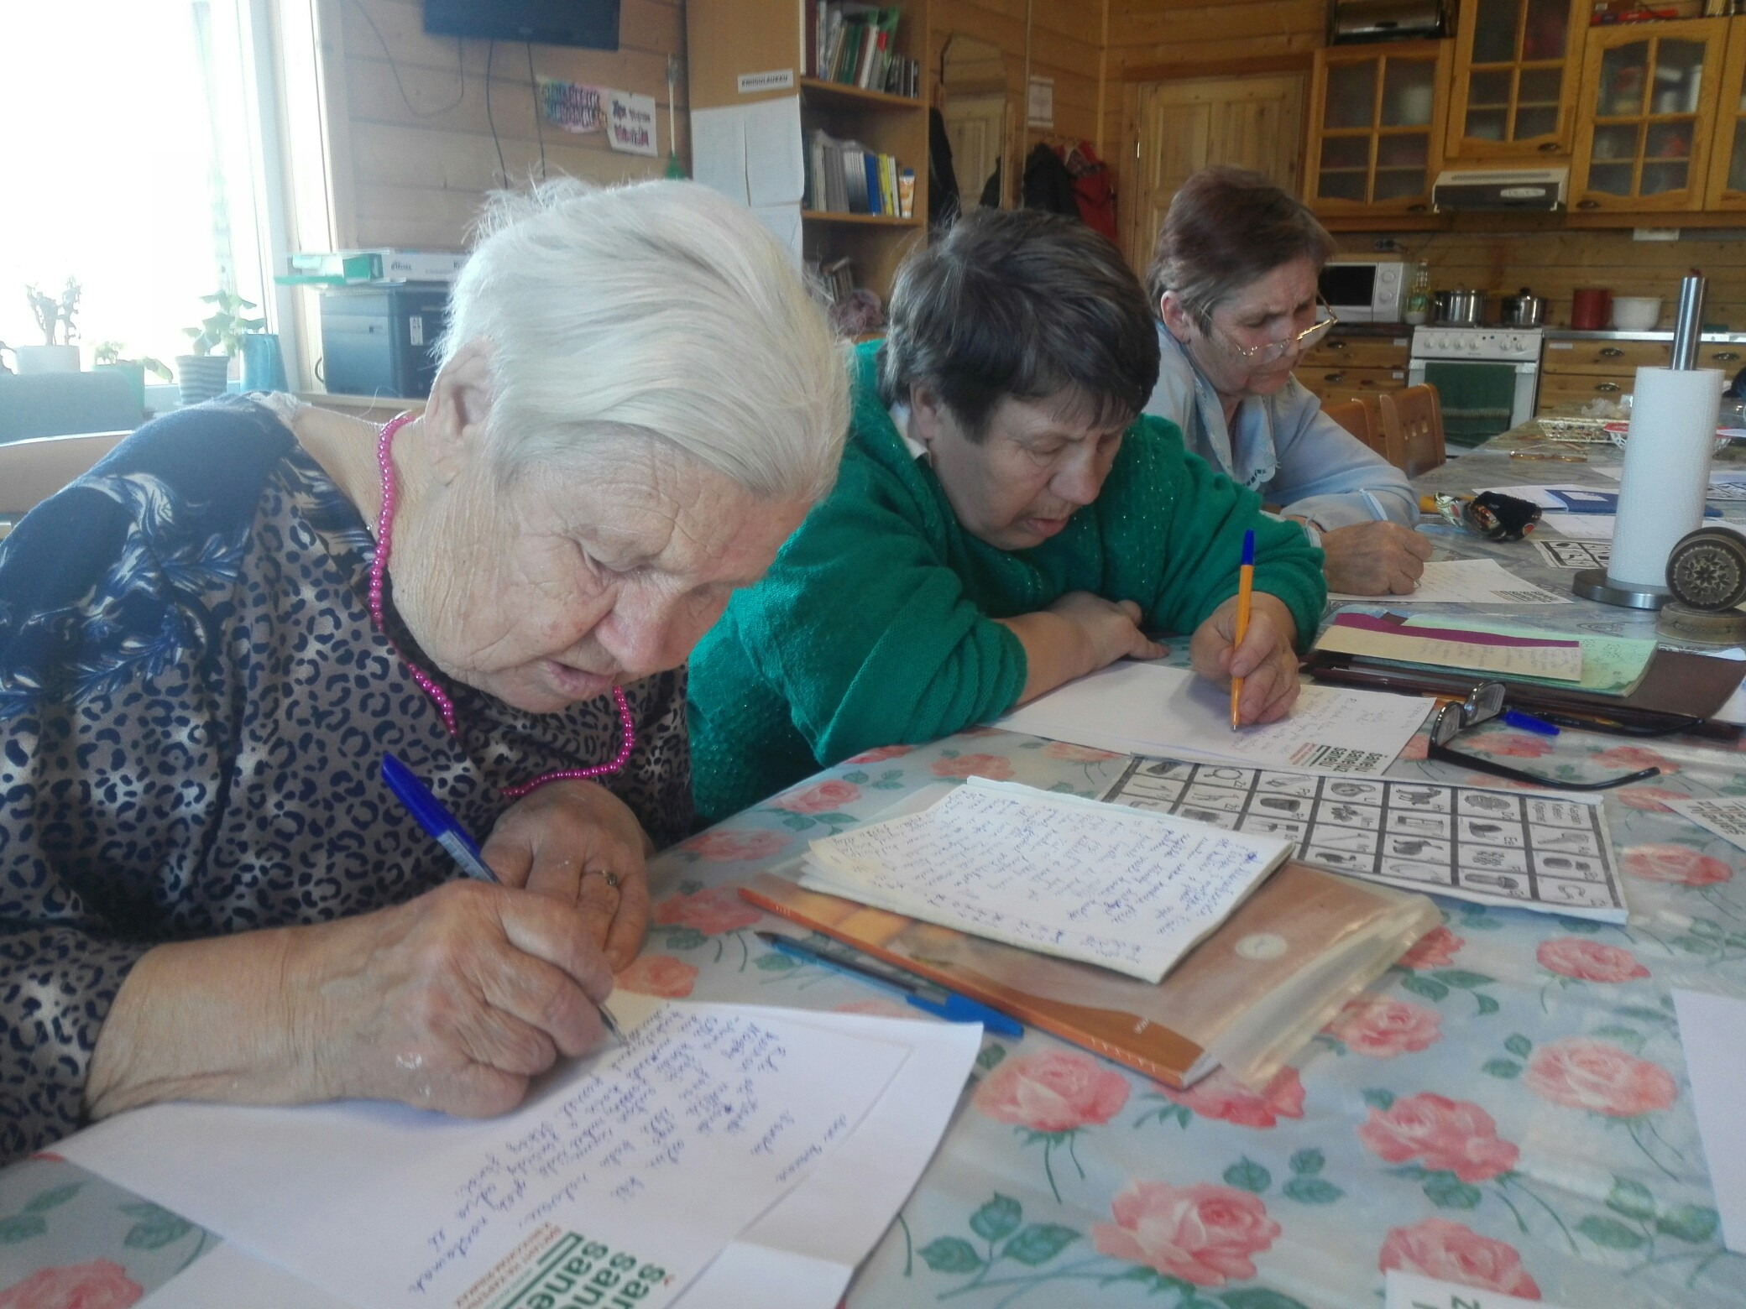
Karelian Language House

Slide 7
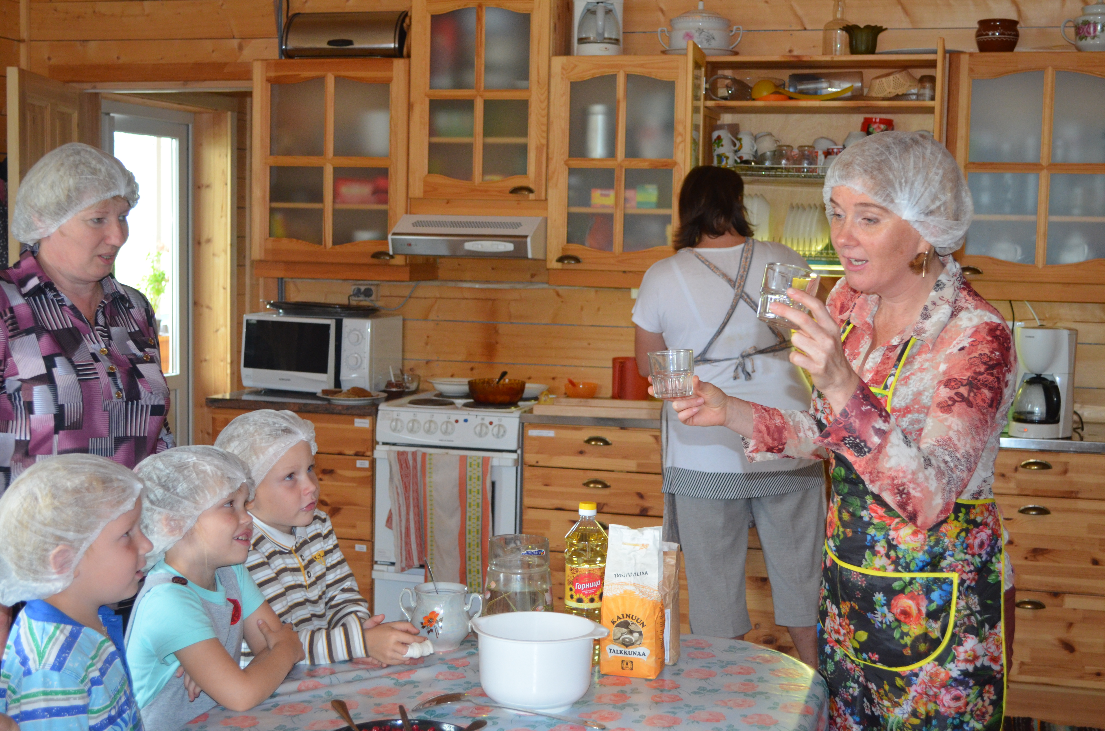
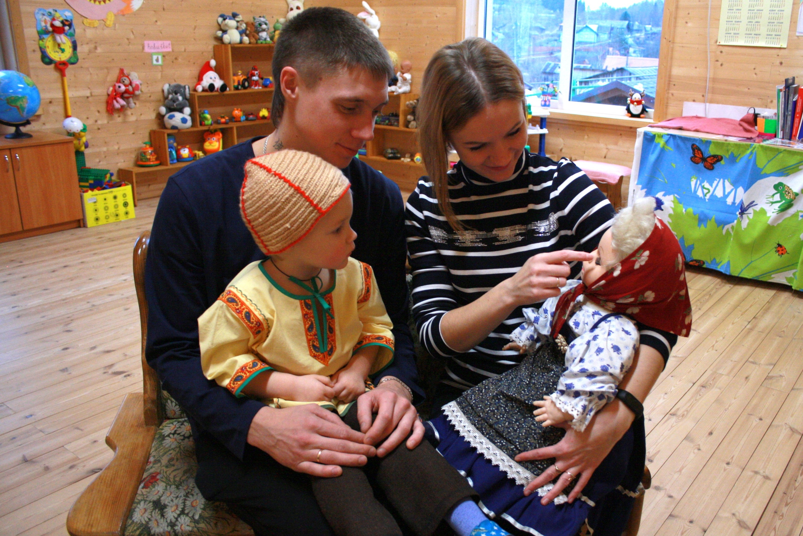
Community-ran «kielipezä» / «language nest»

Slide 8
www.sana2019.ee
Finno-Ugric Language Activism in Real-life Cases

Slide 9
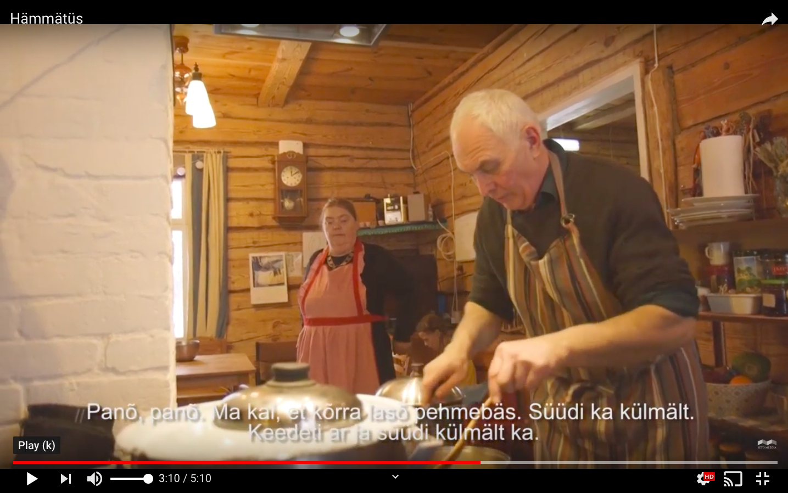
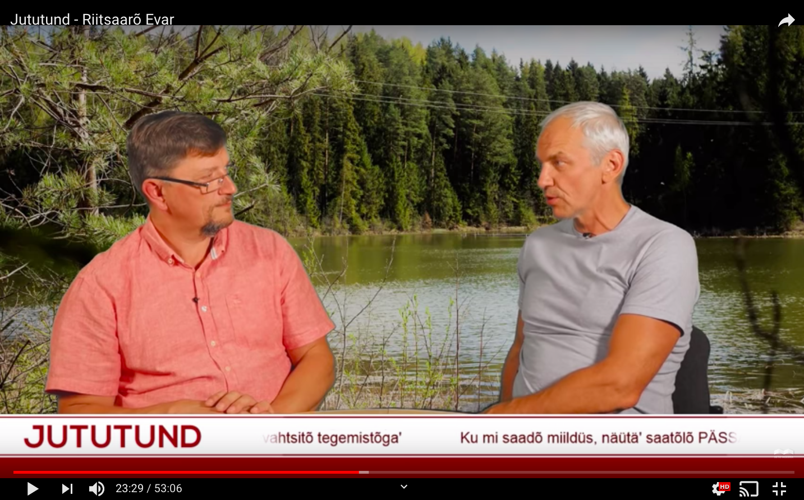
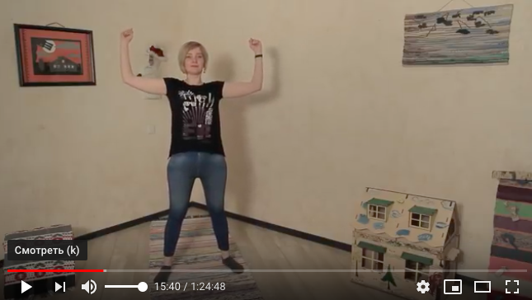
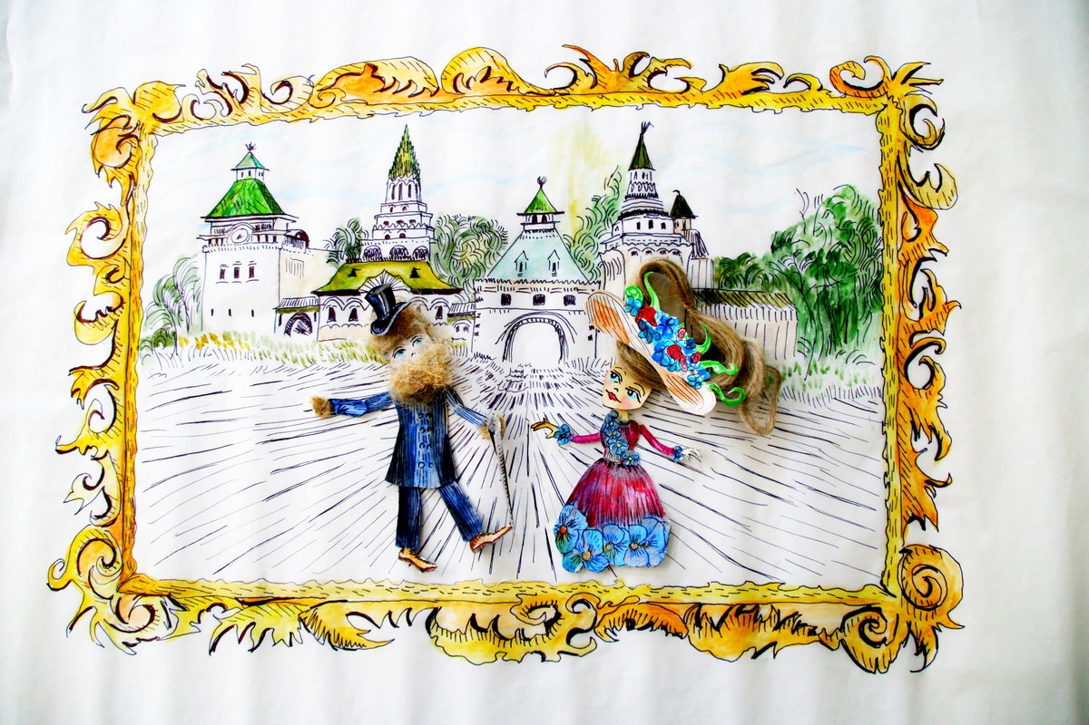
Karelian-Language Animation
Learning Seto Language With the Help of Ethnic Cuisine
Internet TV in Seto language
Breathing Exercises Video Course in Karelian

Slide 10
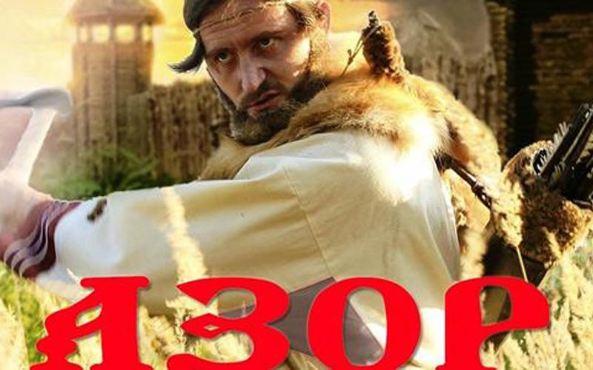
Finno-Ugric Cinema Supported by the Community

Slide 11
Indigenous languages in cyberspace

Slide 12
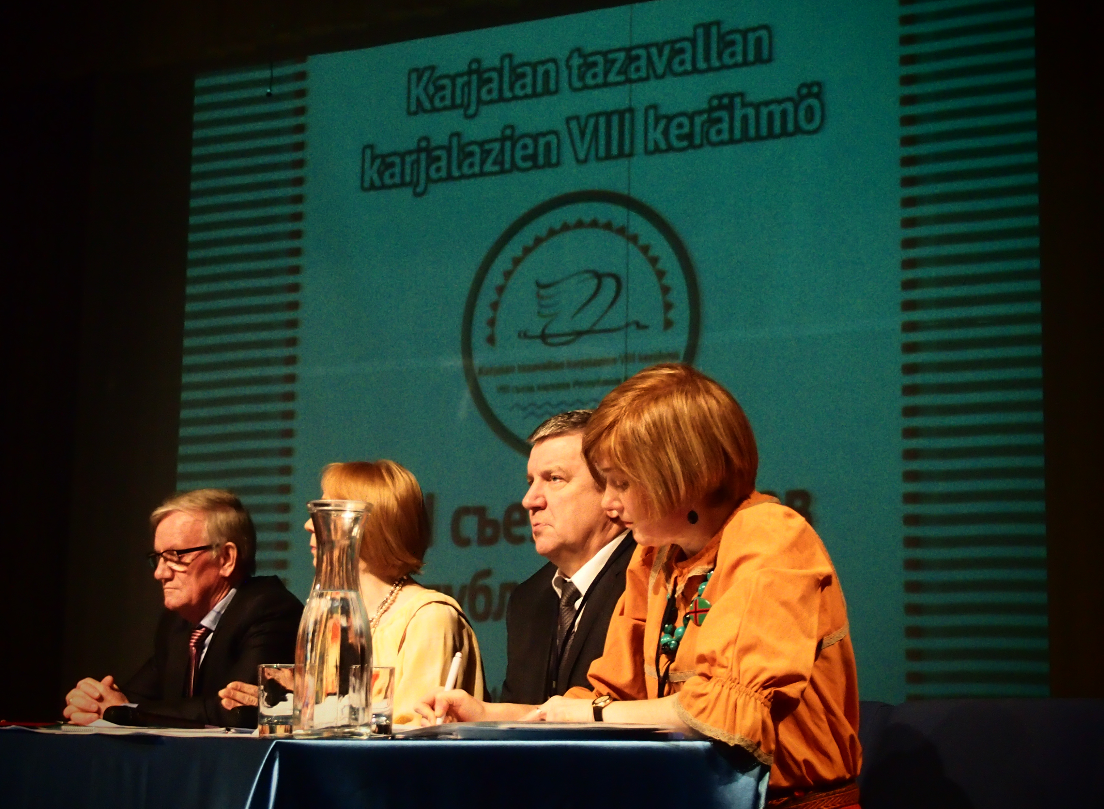
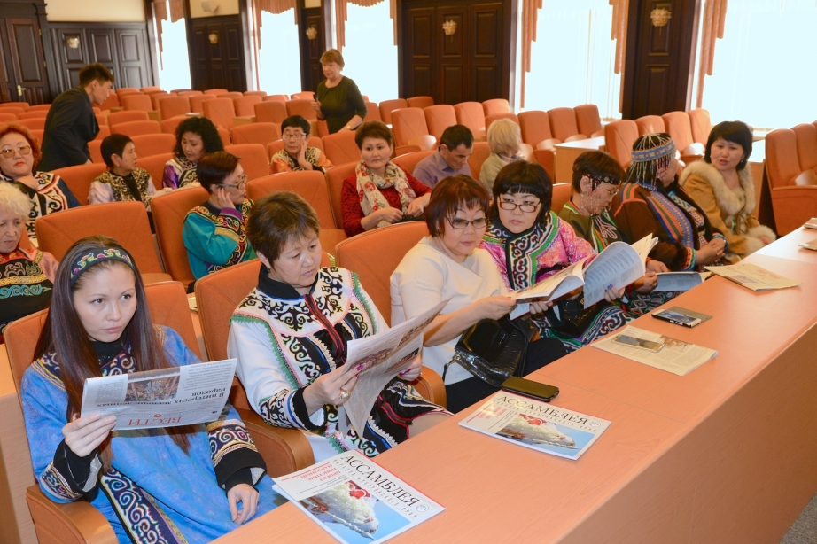
Strong self-governance institutions

Slide 13
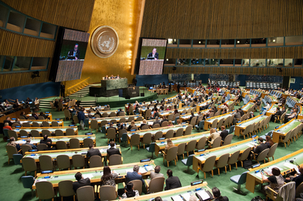
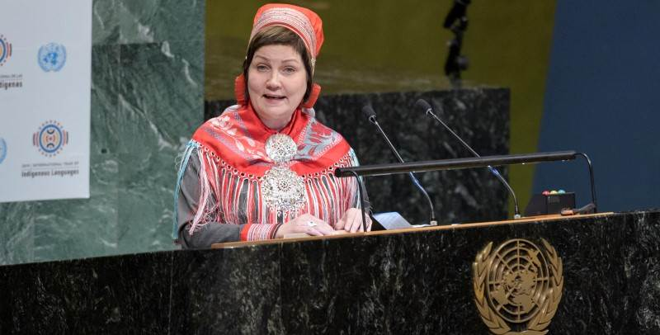
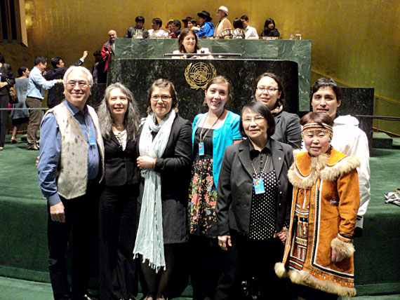
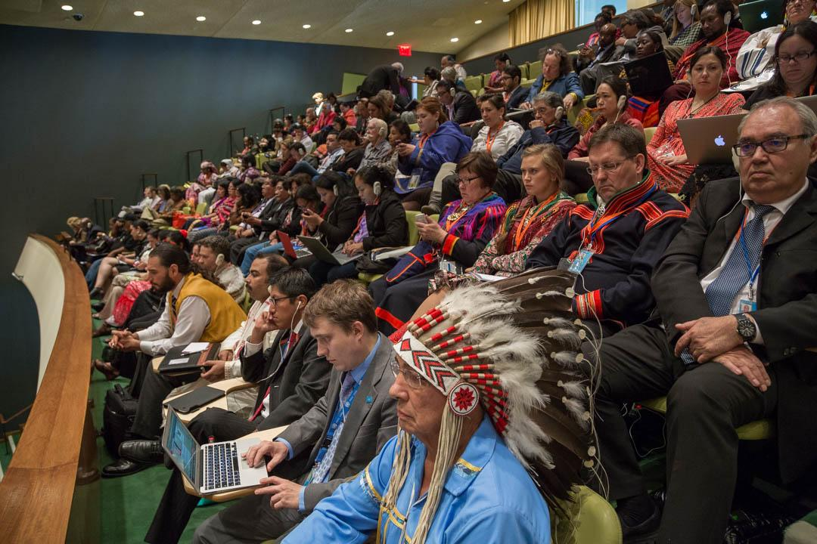
Arctic Indigenous Peoples Championing in the United Nations

Slide 14
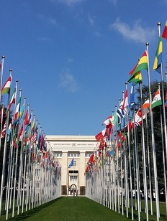
Shift of paradigm: from cultural heritage to human rights based approach
“…an opportunity for states and indigenous peoples to remedy injustices in the realm of language rights, and to undertake preservation and revitalization measures, which earlier have seemed impossible or untimely”

